Slide 2
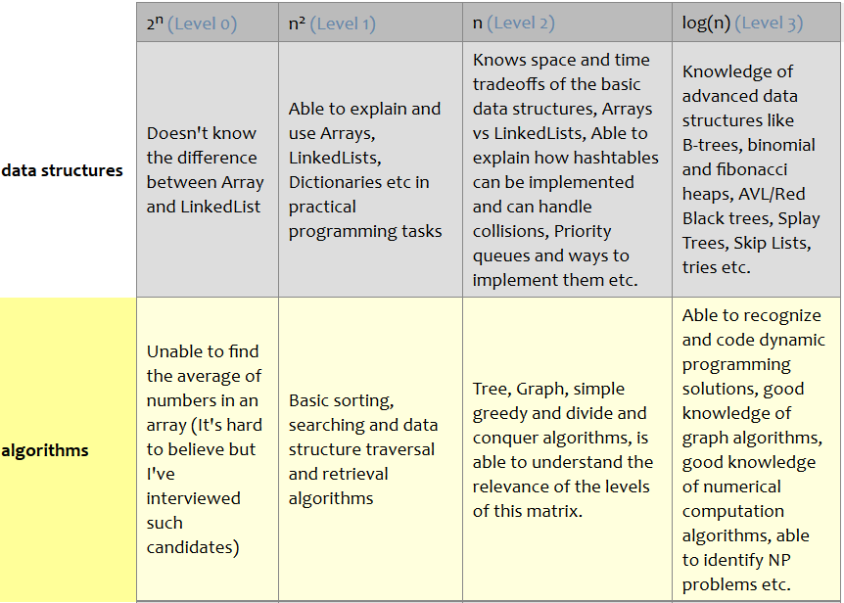
Welcome to CS202!
The world only cares about — and pays off on —
what you can do with
what you know (and it doesn’t care how you learned it)
Laszlo Bock, Senior VP, Google
Source: http://www.starling-software.com/employment/programmer-competency-matrix.html
<number>

Slide 3
Instructor Details and Course Overview
Course in Charge: Co-instructor:
Prof. Viraj Kumar Prof. Madhura V.
viraj.kumar@pes.edu madhura.v.madhu@gmail.com
Office: opp. Room B-301 Office: Staff Room (Ground Flr)
Course policies:
T1 and T2 are computer-based and worth 15% each
Comprehensive Final is written and worth 40%
One A4-sized handwritten cheat-sheet allowed on all exams
T3 policy
Project (groups of 2 or 3, no exceptions): Part 1 (5%) and Part 2 (20%)
Cheating Policy: Any attempt to pass off someone else’s work as your own, or to assist someone else (actively or passively) in such an effort, is considered cheating. The penalty for any such offence will be zero for all involved students.
<number>

Slide 4
Course Project: Two Options
Fast track: Complete project in Data Structures Made Easy (UCSD); coursera.org/learn/data-structures-optimizing-performance (Java)
NOT: coursera.org/learn/data-structures
Register by Aug 6, complete work by Sept 11, viva date TBA
Regular track: Complete in-course project (any language other than C)
Can combine this with other course projects (e.g., Web Tech.)
Common concept: Edit Distance between two words (operations allowed: insert, modify, delete one letter at a time)
e.g., time → stime → spime → spame → space (edit distance = 4)
A twist: intermediate words must be valid English words (vocab. game)
time → tame → fame → face → pace → space (edit distance = 5)
<number>

Slide 5
Course Project: Two Options
Fast track: Complete project in Data Structures Made Easy (UCSD); coursera.org/learn/data-structures-optimizing-performance (Java)
NOT: coursera.org/learn/data-structures
Register by Aug 6, complete work by Sept 11, viva date TBA
Regular track: Complete in-course project (any language other than C)
Can combine this with other course projects (e.g., Web Tech.)
Common concept: Edit Distance between two words (operations allowed: insert, modify, delete one letter at a time)
e.g., time → stime → spime → spame → space (edit distance = 4)
A twist: intermediate words must be valid English words (vocab. game)
time → tame → fame → face → pace → space (edit distance = 5)
<number>

Slide 6

Data Structures in C
IEEE Spectrum: Top Programming Languages, July 26, 2016
spectrum.ieee.org/static/interactive-the-top-programming-languages-2016
After two years in second place, C has finally edged out Java for the top spot. Staying in the top five, Python has swapped places with C++ to take the No. 3 position, and C# has fallen out of the top five to be replaced with R.
<number>
Notes:
<number>

Slide 7
Recursion
What happens when this program is compiled and run?
#include <stdio.h>
int f(int *a, int n) {
if(n == 0) { return 0; }
return a[n-1];
}
int main() {
int array[3] = {1, 2, -3};
printf("%d\n", f(array, 3));
return 0;
}
Now, let us make one modification
What is in <stdio.h>?
Pass by value? reference?
Else needed?
Address calculation
+ f(a, n-1);
f
a = array, n = 2
S
t
a
c
k
f
a = array, n = 3
main
arguments
return address
local vars
Loader
<number>
Notes:
<number>

Slide 8
Structures and Pointers
A company is hiring, and wants to make relevant data of shortlisted candidates available to interviewers
in memory
typedef struct student {
double gpa;
char *github;
} student_t;
#define MAX_STUDENTS 100
int main() {
student_t list[100];
return 0;
}
Header file (.h)
list[MAX_STUDENTS];
<number>
Notes:
<number>

Slide 9
Structures and Pointers
A company is hiring, and wants to make relevant data of shortlisted candidates available to interviewers
in memory
typedef struct student {
double gpa;
char *github;
} student_t;
#define MAX_STUDENTS 100
int main() {
student_t list[100];
return 0;
}
Header file (.h)
list[MAX_STUDENTS];
<number>
Notes:
<number>

Slide 10
Main program expanded
typedef struct student {
double gpa;
char *github;
} student_t;
#define MAX_STUDENTS 100
double get_gpa(student_t *, int);
int main() {
student_t list[MAX_STUDENTS];
int i;
printf("Enter student no. "); scanf("%d", &i);
printf("GPA is: %lf\n", list[i].gpa);
return 0;
}
Details abstracted away
in a header file (.h)
get_gpa(list, i));
Key point: Tomorrow, if I change the
way I organize my data, I will need to
change lots of lines of code like this.
<number>
Notes:
<number>

Slide 11
Interface/Abstraction
Once the client and implementer agree on an interface (a.k.a. abstraction):
the client is free to write any code using the interface functionality
the implementer is free to modify the implementation
neither group needs to inform the other!
You will see this idea all over CS:
Client code
Interface
Implementation
Software
Instruction Set
Architecture
Hardware
<number>

Slide 12
Code for get_gpa
double get_gpa(student_t *list, int i) {
return list[i].gpa;
}
Question: What if index i is out of bounds?
// BREAKS agreed-upon function prototype!
int get_gpa(student_t *list, int i, double *g) {
if(i < 0 || i >= MAX_STUDENTS) { return 0; }
*g = list[i].gpa;
return 1;
}
Complete the set_gpa implementation
Write the prototype for get_github and
then write the implementation
printf("Enter student no. "); scanf("%d", &i);
double g;
if(get_gpa(list, i, &g)) {
printf("GPA is: %lf\n", g);
} else { ... }
<number>
Notes:
<number>

Slide 13
Code for set_github
Your friend wrote this function − critique it:
void set_github(student_t *list, int i, char *gh) {
list[i].github = gh;
}
Suppose the main function contains:
int main() {
student_t list[MAX_STUDENTS];
char URL[20];
scanf("%s", URL); set_github(list, 0, URL);
scanf("%s", URL); set_github(list, 1, URL);
return 0;
}
<number>
Notes:
<number>

Slide 14
Corrected (?) code for set_github
void set_github(student_t *list, int i, char *gh) {
int len = strlen(gh);
list[i].github = (char *) malloc(len);
int j;
for(j = 0; j < len; ++j) {
list[i].github[j] = gh[j];
}
}
Freeing memory:
void free_memory(student_t *list) {
for(int i = 0; i < MAX_STUDENTS; ++i) {
free(list[i].github);
}
}
+ 1;
*sizeof(char));
strncpy(list[i].github, gh, len);
<number>
Notes:
<number>

Slide 15
Pointers to functions
The free_memory function we just wrote has this structure:
for all array elements
do something with element i // “do something” = “free github”
Similarly, we may wish to initialize all data, print all data, …
Would like to do this:
void forall(student_t *list) {
for(int i = 0; i < MAX_STUDENTS; ++i) {
task( list[i] ); // where task can be "anything"
}
}
&
Two problems:
We need to make task an argument to forall
If task modifies list[i], then we must pass a pointer to list[i] (a good idea anyway − why?)
<number>
Notes:
<number>

Slide 16
Pointers to functions: syntax
base address
pointer to i^{th} element
void forall(student_t *list, void (*task)(student_t *)) {
for(int i = 0; i < MAX_STUDENTS; ++i) {
task(&list[i]); // no need to say *task
}
}
void init_task(student_t *s) {
s->gpa = 0.0; // same as: (*s).gpa = 0.0;
s->github = NULL;
}
void free_task(student_t *s) {
if(s->github) {
free(s->github);
s->github = NULL;
}
}
int main() {
...
forall(list, init_task);
...
forall(list, free_task);
return 0;
}
<number>
Notes:
<number>

Slide 17
A more advanced forall
student_t *forall(student_t *list,
int (*task)(student_t *, void *)
void *arg) {
for(int i = 0; i < MAX_STUDENTS; ++i) {
if(!task(&list[i], arg)) {
return &list[i];
}
}
return NULL;
}
int sum(student_t *s, void *arg) {
double *total = (double *) arg;
*total = *total + s->gpa;
return 1;
}
int find(student_t *s, void *arg) {
char *gh = (char *) arg;
return strcmp(s->github, gh);
}
double total = 0.0;
forall(list, sum, &total);
student_t *s = forall(list, find, "CoolCoder");
if(s) { printf("%lf\n", s->gpa); }
<number>
Notes:
<number>

Slide 18
Lists
A List is a finite sequence of values
may be empty
duplicate entries allowed, and order matters (unlike a Set)
each list item has a position (we will start numbering from 0)
For C code:
gcc –c implementation.c
gcc –c client.c
gcc client.o implementation.o (linking)
Client code
Can be compiled
and distributed
separately!
List ADT
Header file
(List.h)
Implementation
implementation.o
client.o
<number>
Notes:
<number>

Slide 19
A List ADT
There should be a way to:
create an initially empty list
delete a list (i.e., free up any dynamically allocated memory)
determine whether a list is empty (more generally: its size)
insert an element at position i (special cases: append, prepend)
delete first/last/all occurrence(s) of some data
determine the first/last list entry at which some data appears
read/write the data in that list entry
find the position (starting from 0) at which some data first appears
check if two lists are equal (as sequences)
iterate through the list
perform a given task on all items in the list
Some languages (e.g., Python) support lists with these features and more
<number>
Notes:
<number>

Slide 20
List.h: First Attempt
#ifndef LIST_H
#define LIST_H
typedef void* List;
// create an initially empty list: we will use NULL
// delete a list (and free up any associated memory)
void freeList(List list);
#endif
Solution: Pointer to IMPLementation (PIMPL)
see: http://stackoverflow.com/questions/8972588/is-the-pimpl-idiom-really-used-in-practice
Need to define type for List…
…which defeats the purpose!
<number>
Notes:
<number>

Slide 21
List.h (partial)
#ifndef LIST_H
#define LIST_H
typedef void* ListEntry;
void setData(ListEntry, int);
int getData(ListEntry);
typedef void* List;
void freeList(List);
int isEmpty(List);
int size(List);
List append(List, int);
int findPosition(List, int);
ListEntry start(List);
ListEntry next(List, ListEntry);
ListEntry forall(List, int(*task)(int, void*), void*);
#endif
<number>
Notes:
<number>

Slide 22
List Implementation 1: fixed-size array
Idea: We will represent the list using an array of fixed size (say 1000)
What if we try to append more than 1000 items?
List append(List, int);
we will return NULL to indicate failure
#ifndef ARRAYLIST1_H
#define ARRAYLIST1_H
#define FIXED_SIZE 1000
typedef struct arraylist {
int array[FIXED_SIZE];
int listSize;
} ArrayList;
#endif
36 | −417 | … | 5516 | … | 341
listSize
Client:
List myList = NULL;
…
List newList =
append(myList, 5);
if(newList != NULL) {
myList = newList;
} else { ... }
<number>
Notes:
<number>

Slide 23
List.h (partial)
#ifndef LIST_H
#define LIST_H
typedef void* ListEntry;
void setData(ListEntry, int);
int getData(ListEntry);
typedef void* List;
void freeList(List);
int isEmpty(List);
int size(List);
List append(List, int);
int findPosition(List, int);
ListEntry start(List);
ListEntry next(List, ListEntry);
ListEntry forall(List, int(*task)(int, void*), void*);
#endif
<number>
Notes:
<number>

Slide 24
List Implementation 1: fixed-size array
Idea: We will represent the list using an array of fixed size (say 1000)
What if we try to append more than 1000 items?
List append(List, int);
we will return NULL to indicate failure
#ifndef ARRAYLIST1_H
#define ARRAYLIST1_H
#define FIXED_SIZE 1000
typedef struct arraylist {
int array[FIXED_SIZE];
int listSize;
} ArrayList;
#endif
36 | −417 | … | 5516 | … | 341
listSize
Client:
List myList = NULL;
…
List newList =
append(myList, 5);
if(newList != NULL) {
myList = newList;
} else { ... }
<number>
Notes:
<number>

Slide 25
append
ArrayList *toArrayList(List list) {
ArrayList *this = (ArrayList *) list;
if(this != NULL) { return this; }
if( (this = (ArrayList *) malloc(sizeof(ArrayList)))
!= NULL) {
this->listSize = 0;
}
return this;
}
List append(List list, int data) {
ArrayList *this = toArrayList(list);
if(this == NULL) {
return NULL;
}
this->array[this->listSize] = data;
this->listSize++;
return this;
}
ArrayList *this = (ArrayList *) list;
|| this->listSize == FIXED_SIZE) {
<number>
Notes:
<number>

Slide 26
freeList, isEmpty, size and findPosition
void freeList(List list) {
if(list != NULL) { free(list); }
}
int isEmpty(List list) {
return list == NULL;
}
int size(List list) {
if(list == NULL) { return 0; }
return ((ArrayList *) list)->listSize;
}
int findPosition(List list, int data) {
if(list != NULL) {
ArrayList *this = (ArrayList *) list;
for(int i = 0; i < this->listSize; ++i)
if(this->array[i] == data) { return i; }
}
return -1;
}
|| ((ArrayList *) list)->listSize
== 0;
<number>
Notes:
<number>

Slide 27
prepend
List prepend(List list, int data) {
ArrayList *this = toArrayList(list);
if(this == NULL || this->listSize == FIXED_SIZE) {
return NULL;
}
// copy → and free up array[0]
for(int i = this->listSize; i > 0; --i) {
this->array[i] = this->array[i-1];
}
this->array[0] = data;
this->listSize++;
return this;
}
<number>
Notes:
<number>

Slide 28
prepend
List prepend(List list, int data) {
ArrayList *this = toArrayList(list);
if(this == NULL || this->listSize == FIXED_SIZE) {
return NULL;
}
// copy → and free up array[0]
for(int i = this->listSize; i > 0; --i) {
this->array[i] = this->array[i-1];
}
this->array[0] = data;
this->listSize++;
return this;
}
<number>
Notes:
<number>

Slide 29
insertAt
List insertAt(List list, int data, int i) {
ArrayList *this = toArrayList(list);
if(this == NULL || this->listSize == FIXED_SIZE
|| i < 0 || i > this->listSize) {
return NULL;
}
// copy → and free up array[i]
for(int j = this->listSize; j > i; --j) {
this->array[j] = this->array[j-1];
}
this->array[i] = data;
this->listSize++;
return this;
}
) {
List prepend(List list, int data) {
return insertAt(list, data, 0);
}
<number>
Notes:
<number>

Slide 30
Try one: deleteAt
List deleteAt(List list, int i) {
ArrayList *this = (ArrayList *) list;
if(this == NULL || i < 0 || i >= this->listSize) {
return NULL;
}
if(data != NULL) { *data = this->array[i]; }
// copy ← and overwrite array[i]
for(int j = i+1; j < this->listSize; ++j) {
this->array[j-1] = this->array[j];
}
this->listSize--;
return this;
}
, int *data) {
<number>
Notes:
<number>

Slide 31
Find the bug: deleteAll
List deleteAll(List list, int data) {
if(list == NULL) { return NULL; }
ArrayList *this = (ArrayList *) list;
for(int i = 0; i < this->listSize; ++i) {
if(this->array[i] == data) {
this = deleteAt(this, i, NULL);
}
}
return this;
}
<number>
Notes:
<number>

Slide 32
A better deleteAll?
List deleteAll(List list, int data) {
if(list == NULL) { return NULL; }
ArrayList *this = (ArrayList *) list;
ArrayList *result = NULL;
for(int i = 0; i < this->listSize; ++i) {
if(this->array[i] != data) {
result = append(result, this->array[i]);
}
}
freeList(this);
return result;
}
“most of the work”
“cheap”
Differences
if(this->array[i] == data) {
this = deleteAt(this, i, NULL);
}
Space-Time
Tradeoff
“expensive”
<number>
Notes:
<number>

Slide 33
start, next
ListEntry start(List list) {
if(list == NULL) { return NULL; }
return ((ArrayList *) list)->array;
}
ListEntry next(List list, ListEntry current) {
if(list == NULL || current == NULL) { return NULL; }
ArrayList *this = (ArrayList *) list;
int *curr = (int *) current;
return curr + 1 < (this->array + this->listSize) ?
curr + 1 : NULL;
}
<number>
Notes:
<number>

Slide 34
List Implementation 2: dynamically allocated array
Idea: If the array fills up, we will reallocate a larger block and copy data
Homework: Carefully read the specification of realloc
36 | −417 | … | 5516
listSize
<number>
Notes:
<number>

Slide 35
List Implementation 2: dynamically allocated array
Idea: If the array fills up, we will reallocate a larger block and copy data
#ifndef ARRAYLIST2_H
#define ARRAYLIST2_H
#define INITIAL_SIZE 16
typedef struct arraylist {
int *array;
int size; // how big the array is
int listSize; // how much of it is used
} ArrayList;
#endif
36 | −417 | … | 5516
listSize
<number>
Notes:
<number>

Slide 36
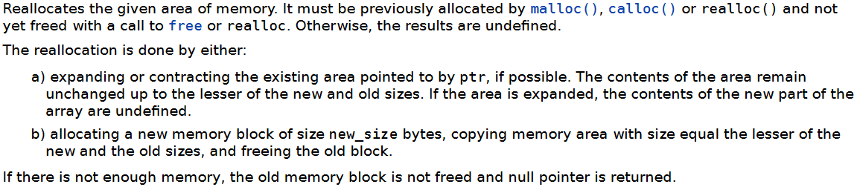
toArrayList
ArrayList *toArrayList(List list) {
ArrayList *this = (ArrayList *) list;
if(this == NULL) { // malloc
if((this = (ArrayList *) malloc(sizeof(ArrayList))) != NULL) {
this->listSize = 0;
if((this->array = (int*)malloc(INITIAL_SIZE*sizeof(int)))!=NULL) {
this->size = INITIAL_SIZE;
} else {
free(this);
this = NULL;
}
}
} else if(this->listSize == this->size) { // realloc
int newSize = 2*(this->size);
int *newArray = (int *) realloc(this->array, newSize * sizeof(int));
if(newArray == NULL) { return NULL; }
this->array = newArray;
this->size = newSize;
}
return this;
}
Recursive definition!
Formal definition of realloc
void *realloc(void *ptr, size_t new_size);
<number>
Notes:
<number>

Slide 37
append, freeList
List append(List list, int data) {
ArrayList *this = toArrayList(list);
if(this == NULL) {
return NULL;
}
this->array[this->listSize] = data;
this->listSize++;
return this;
}
void freeList(List list) {
if(list != NULL) {
free(((ArrayList *) list)->array);
free(list);
}
}
|| this->listSize == FIXED_SIZE) {
<number>
Notes:
<number>

Slide 38
List Implementation 3: linked lists
Definition: A linked list is either empty or consists of a node containing data followed by a linked list
#ifndef LINKEDLIST1_H
#define LINKEDLIST1_H
typedef struct node {
int data;
struct node *next;
} Node;
#endif
Recursive
In LinkedList.c
Node *makeNode(int data, Node *next) {
Node *newNode = (Node *) malloc(sizeof(Node));
if(newNode != NULL) {
newNode->data = data;
newNode->next = next;
}
return newNode;
}
<number>
Notes:
<number>

Slide 39
prepend, size, isEmpty
List prepend(List list, int data) {
return makeNode(data, (Node *) list);
}
int size(List list) {
int result = 0;
for(Node *p = (Node *) list; p != NULL; p = p->next)
++result;
return result;
}
int isEmpty(List list) { return list == NULL; }
if(list == NULL) { return 0; }
return 1 + size(((Node *) list)->next);
<number>
Notes:
<number>

Slide 40
append
List append(List list, int data) {
Node *newNode = makeNode(data, NULL);
if(newNode == NULL || list == NULL) { return newNode; }
Node *p = (Node *) list;
while(p->next != NULL) {
p = p->next;
}
p->next = newNode;
return list;
}
In LinkedList1: prepend is cheap,
size and append are expensive
In ArrayList1: prepend is expensive,
size and append are cheap
In ArrayList2: size is cheap, append
and prepend are expensive (in the
worst case)
In LinkedList2: all 3 will be cheap!
<number>
Notes:
<number>

Slide 41
start, next, getEntry, setEntry
ListEntry start(List list) { return list; }
ListEntry next(List list, ListEntry current) {
return current == NULL ? NULL :
((Node *) current)->next;
}
int getData(ListEntry e) { return ((Node *) e)->data; }
void setData(ListEntry e, int data) {
((Node *) e)->data = data;
}
<number>
Notes:
<number>

Slide 42
findPosition, deleteAll
int findPosition(List list, int data) {
Node *p = (Node *) list;
for(int i = 0; p != NULL; p = p->next, ++i) {
if(p->data == data) { return i; }
}
return -1;
}
List deleteAll(List list, int data) {
if(list == NULL) { return NULL; }
Node *p = (Node *) list;
Node *rec = (Node *) deleteAll(p->next, data);
if(p->data == data) { free(p); return rec; }
p->next = rec;
return p;
}
// Find the bug!
if(list == NULL) { return -1; }
Node *p = (Node *) list;
if(p->data == data) { return 0; }
return 1 + findPosition(p->next, data);
<number>
Notes:
<number>

Slide 43
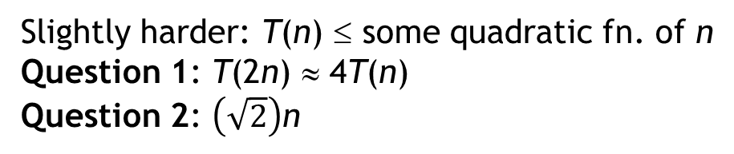
Asymptotic Analysis
“Performance” of operations on data structures (in general) depends on the size n of the data structure
“performance” usually means “time”, but “space” is also important
Notation: T(n) = time to do operation on data structure of size n
Key idea: It is worth studying how T(n) grows for large values of n
Question 1: If we double the data size (n → 2n), then T(n) → ?
Question 2: If tomorrow we have a computer that is twice as fast and we keep the time T(n) = t fixed, how much larger can n become?
Easy case: T(n) ≤ some linear function of n (notation: T(n) is O(n))
Question 1: T(2n) ≈ 2T(n) // for large n, regardless of coefficients!
Question 2: 2n
may be hard to get an exact bound
An O(n) running
time will scale
better than O(n²)
Slightly harder: T(n) ≤ some quadratic fn. of n
Question 1: T(2n) ≈ 4T(n)
Question 2: n
<number>
Notes:
<number>

Slide 44
Comparison of implementations
We have seen three List implementations: ArrayList 1 & 2, LinkedList1
Notes:
“Running time is O(1)” means “running time is at most a constant, regardless of n”
ArrayList1’s append takes O(1) time (fails after FIXED_SIZE reached!)
ArrayList2’s append takes O(n) time in the worst case (it takes O(1) time most of the time)
For deleteAt in arrays, we can get to the deleting position i in O(1) time, but it takes O(n) time to “fill the hole”. For linked lists, getting to position i takes O(n) time, but removing the node takes O(1) time
 | ArrayList1 | ArrayList2 | LinkedList1
prepend | O(n)
append | O(1)
insertAt | O(n)
deleteAt | O(n)
deleteAll | Next slide | Next slide | Next slide
findPosition | O(n)
O(n)
O(n)
O(n)
O(n)
O(n)
O(1)
O(n)
O(n)
O(n)
O(n)
<number>
Notes:
<number>

Slide 45
Two versions of deleteAll
List deleteAll(List list, int data) {
if(list == NULL) { return NULL; }
ArrayList *this = (ArrayList *) list;
ArrayList *result = NULL;
for(int i = 0; i < this->listSize; ++i) {
if(this->array[i] != data) {
result = append(result, this->array[i]);
}
}
freeList(this);
return result;
}
For ArrayList2
O(1)
+ n × O(n)
+ O(1)
which is O(n²)
For ArrayList1
O(1)
+ n × O(1)
+ O(1)
which is O(n)
“most of the work”
“cheap”: O(1)
Differences
if(this->array[i] == data) {
this = deleteAt(this, i, NULL);
}
Space-Time
Tradeoff
“expensive”: O(n)
O(n) time and O(n) extra space
vs. O(n²) time and O(1) extra space
<number>
Notes:
<number>

Slide 46
deleteAll in LinkedList1
List deleteAll(List list, int data) {
if(list == NULL) { return NULL; }
Node *this = (Node *) list;
for(Node *p = this; p->next != NULL; p = p->next) {
if(p->next->data == data) {
Node *q = p->next;
p->next = q->next;
free(q);
}
}
if(this->data == data) {
Node* p = this;
this = p->next;
free(p);
}
return this;
}
O(n) time and O(1) extra space!
<number>
Notes:
<number>

Slide 47
List Implementation 4: LinkedList2
#ifndef LINKEDLIST2_H
#define LINKEDLIST2_H
typedef struct node {
int data;
struct node *next;
} Node;
typedef struct linkedlist {
Node *head;
Node *tail;
int listSize;
} LinkedList;
#endif
 | LinkedList2
prepend | O(1)
append | O(1)
insertAt | O(n)
deleteAt | O(n)
deleteAll | O(n)
findPosition | O(n)
size | O(1)
head
tail
<number>
Notes:
<number>

Slide 48
append in O(1) time
List append(List list, int data) {
Node *newNode = makeNode(data, NULL);
if(newNode == NULL) { return NULL; }
LinkedList *this = toLinkedList(list);
if(this == NULL) {
free(newNode);
return NULL;
}
if(this->listSize == 0) {
this->head = this->tail = newNode;
} else {
this->tail = this->tail->next = newNode;
}
this->listSize++;
return this;
}
like toArrayList
<number>
Notes:
<number>

Slide 49


Research Paper
B. Boothe (Computer Science Department, University of Southern Maine) Using Real Execution Timings to Enliven a Data Structures Course, Frontiers in Education: Computer Science (FECS), 2012.
Abstract: Which is faster, an array list or a linked list? In our data structures course we increase the engagement of our students by asking them to predict the outcome of a future race between competing data structures. We record their predictions for future validation, and subsequently as we analyze the data structures, students are more engaged in the analysis because it either lends credence or doubt towards the accuracy of their predictions. Some of their expectations get radically broken by the analysis, and in the end everyone gets surprised by the actual runtime results. Everyone benefits because the class is more engaging and the results are more memorable.
zero
citations
<number>
Notes:
<number>

Slide 50
The Race
Our students know that array lists have to periodically grow the internal array by creating a new one and copying everything over, and they know that it is painfully slow to insert at the start of an array list and move everything up. They have also been convinced linked lists are slick because of how efficiently they can insert new values between others without needing to copy anything.
Take n random integers and insert them into the data structure while maintaining the data structure in sorted order at every insert. After each insert, search for some random integer.
Make predictions on which will be faster, array lists or linked lists, running on a real computer.
<number>
Notes:
<number>

Slide 51
Student Predictions
The majority of groups always predict that linked lists will be either a little faster or a lot faster than array lists. For justifications they cite the high cost of inserting into the array and the cost of repeatedly growing the array to make it larger. In contrast, usually at least one group notes that the sorted array can be binary searched much faster than the linear search required of the linked list, and thus they predict that the array list will be faster. Finally, there is usually another group that remembers and utilizes asymptotic analysis…
int binarySearch(int *a, int lo, int hi, int data) {
if(lo > hi) { return -1; } // not found
int mid = (lo + hi)/2;
if(a[mid] < data)
return binarySearch(a, mid+1, hi, data);
if(a[mid] > data)
return binarySearch(a, lo, mid-1, data);
return mid;
}
Initially: lo = 0, hi = n-1
O(log n)
<number>
Notes:
<number>

Slide 52
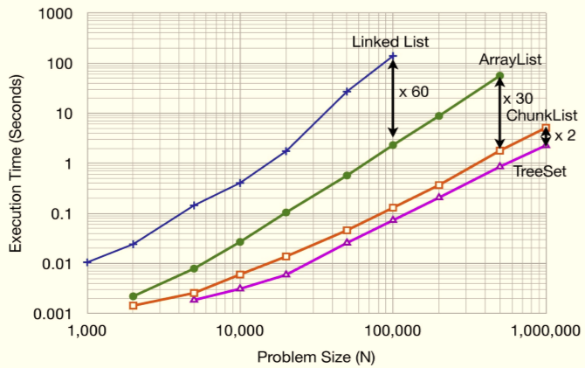
Asymptotic analysis
Repeat n times:
insert item into list in sorted order
search for some item
Thus, the asymptotic analysis for both is O(n²)
Real execution time from a 2.4 GHz Intel Core 2 Duo with a 2MB L2 cache and 3.25 GB of RAM running Java 6
ArrayList | LinkedList
O(n)
O(log n)
O(n)
O(n)
Note: log-log plot
<number>
Notes:
<number>

Slide 53
Why 60x slower??
Focus on the expensive operations:
ArrayList: move items in memory n calls to System.arraycopy()
LinkedList: iterate and compare n² calls to comparator/next
Memory:
ArrayList uses 3 times less memory than LinkedList (for the Java implementation)
More data is in the L1 cache, so faster performance
Bottom line: If asymptotic complexities of two approaches are the same, then real execution times do matter!
<number>
Notes:
<number>

Slide 54
Stacks
A stack is a data structure that supports inserting and deleting data, with a special property
The LIFO property: the Last item In is the First item Out
Example: Activation records
Insert: push onto the stack
Delete: pop from the stack
Signature for pop: Stack pop(Stack s, int *data);
Additional operations:
Is the stack empty?
If not, what is the top item in the stack (peek)
<number>
Notes:
<number>

Slide 55
Stack Implementation
With ArrayList2 implementation:
push as append O(1) time usually, O(n) time worst case
pop as deleteLast O(1) time
isEmpty?
peek?
With LinkedList1 implementation:
push as prepend O(1) time
pop as deleteFirst O(1) time
isEmpty?
peek?
<number>
Notes:
<number>

Slide 56
Queues
A queue is a data structure that supports inserting and deleting data, with a special property
The FIFO property: the First item In is the First item Out
Example: A queue of customers
Insert: enqueue
Delete: dequeue
Additional operations:
Is the queue empty?
Concatenate two queues
Question: Can each of these operations be implemented in O(1) time using any one of our list data structures?
<number>
Notes:
<number>

Slide 57
Stacks and Queues
A stack is a data structure that supports inserting and deleting data, with a special property (LIFO): the Last item In is the First item Out
Insert: push onto the stack
Delete: pop from the stack
A queue is a data structure that supports inserting and deleting data, with a special property (FIFO): the First item In is the First item Out
Insert: enqueue
Delete: dequeue
Fast implementations:
Stack: LinkedList1 will have O(1) worst-case performance
Queue: LinkedList2 will have O(1) worst-case performance
<number>
Notes:
<number>

Slide 58
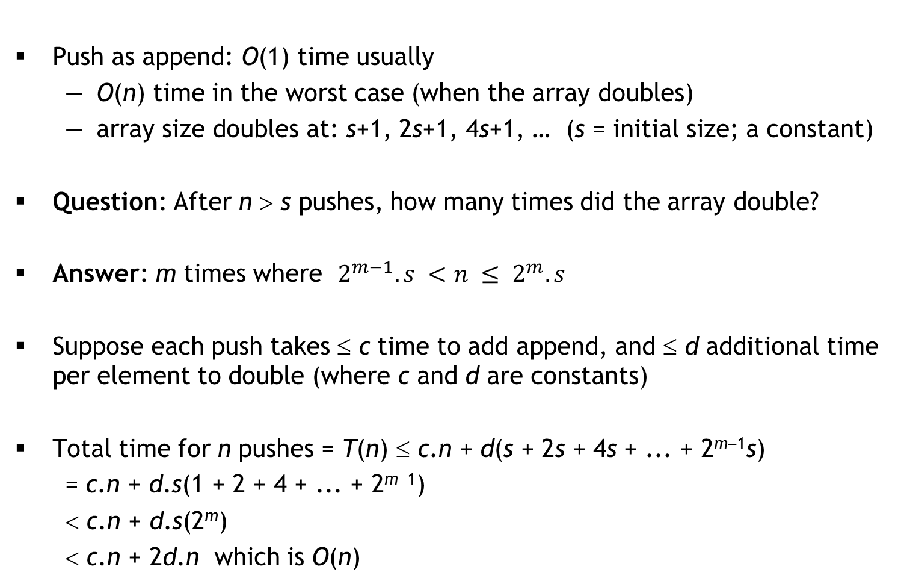
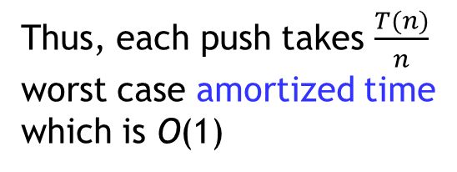
ArrayList2 implementation of Stack
Push as append: O(1) time usually
O(n) time in the worst case (when the array doubles)
array size doubles at: s+1, 2s+1, 4s+1, … (s = initial size; a constant)
Question: After n > s pushes, how many times did the array double?
Answer: m times where
Suppose each push takes ≤ c time to add append, and ≤ d additional time per element to double (where c and d are constants)
Total time for n pushes = T(n) ≤ c.n + d(s + 2s + 4s + ... + 2^{m−1}s)
= c.n + d.s(1 + 2 + 4 + ... + 2^{m−1})
< c.n + d.s(2^{m})
< c.n + 2d.n which is O(n)
Thus, each push takes
worst case amortized time
which is O(1)
<number>
Notes:
<number>

Slide 59
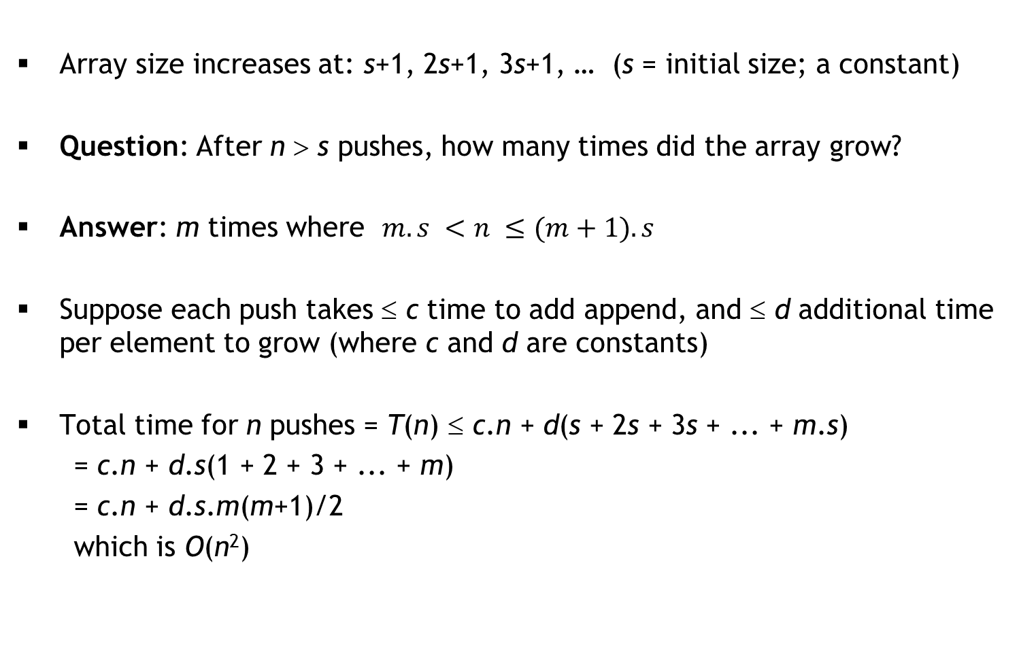

ArrayList2: growing by constant instead of doubling
Array size increases at: s+1, 2s+1, 3s+1, … (s = initial size; a constant)
Question: After n > s pushes, how many times did the array grow?
Answer: m times where
Suppose each push takes ≤ c time to add append, and ≤ d additional time per element to grow (where c and d are constants)
Total time for n pushes = T(n) ≤ c.n + d(s + 2s + 3s + ... + m.s)
= c.n + d.s(1 + 2 + 3 + ... + m)
= c.n + d.s.m(m+1)/2
which is O(n²)
Thus, each push takes
worst case amortized time
which is O(n)
<number>
Notes:
<number>

Slide 60
Interview Questions
Standard ones:
Given two sorted queues Q1 and Q2, create a new sorted queue containing the elements of Q1 and Q2 in sorted order
Given a Stack implementation, implement a Queue
Given a Queue implementation, implement a Stack
Given a linked list of unknown length, determine whether the last element points to NULL, or links back to some earlier node
Dr. Ram’s question: What data structure will you use for Sudoku?
My question: We want to maintain a growing list of integers and support “find” and “insert” operations. For “find”, the data structure must have excellent worst-case performance, but “insert” can be occasionally expensive so long as the amortized time is good.
Idea: Maintain two ArrayLists: Sorted (large) and Unsorted (small). New data is appended to Unsorted in O(1) time, and find searches for data in Sorted using binary search and Unsorted using linear search. When Unsorted gets large, sort Unsorted and merge with Sorted.
<number>
Notes:
<number>

Slide 61
Stacks Application: Evaluating Expressions
Write a function to evaluate these expressions:
Infix notation
A + B
(A + B) * C
A * B + C
A + B * C
Maintain a stack S (initially empty)
For each token t:
If t is an operand, push(S, t)
If t is an operator:
pop the top 2 operands p1 and p2 from the stack
push(S, p2 t p1)
Pop the stack to produce the answer
Postfix notation
A B +
A B + C *
A B * C +
A B C * +
<number>
Notes:
<number>

Slide 62
Infix to Postfix
Create an empty stack S for operators
Create an empty list L for output
For each token t:
If t is an operand, append(L, t)
If t is a left parenthesis, push(S, t)
If t is a right parenthesis:
pop S until the corresponding left parenthesis is removed
append each popped operator to L
If t is an operator:
repeatedly peek S, pop any operators of high precedence than t and append them to L
push(S, t)
Pop any remaining operators in S and append them to L
<number>
Notes:
<number>

Slide 63
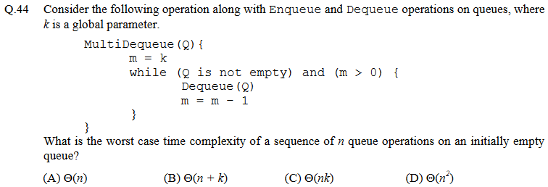
GATE question (CS, 2013)
<number>
Notes:
<number>

Slide 64
Interview Question
Consider this infinite 2D grid:
You are given:
the initial point
up() and right() functions
Goal: find the target
Your friend’s solution:
target
initial
D = empty(); // stack/queue
insert(D, initial); // push/enqueue
while(!isEmpty(D)) {
p = delete(D); // pop/dequeue
if(p == target) { return; }
insert(D, right(p));
insert(D, up(p));
}
<number>
Notes:
<number>

Slide 65
Deques
A double-ended queue (or deque) is a queue that supports enqueue and dequeue operations at both the front and rear of the queue:
enqueue_f, enqueue_r
dequeue_f, dequeue_r
Linked list implementation of a deque:
typedef struct linkedlist2 {
Node *head;
Node *tail;
int listSize;
} LinkedList2;
head
tail
dequeue_f
head = head->next
enqueue_r
tail->next =
new node
enqueue_f
p = new node
p->next = head
head = p
<number>

Slide 66
Linked list implementation: dequeue_r
void dequeue_r(LinkedList2 *dq, int *ans) {
if(dq == NULL || dq->head == NULL) { return; }
Node *p = dq->head; Node *q = dq->tail;
if(p == q) {
dq->head = dq->tail = NULL;
} else {
while(p->next != q) { p = p->next; }
p->next = NULL;
dq->tail = p;
}
dq->listSize--;
if(ans != NULL) { *ans = q->data; }
free(q);
}
O(n)
<number>

Slide 67
Faster implementation: doubly linked lists
typedef struct dllnode {
int data;
struct dllnode *prev;
struct dllnode *next;
} DLL_node;
We can now implement a deque as follows:
typedef struct deque {
DLL_node *head;
DLL_node *tail;
int size;
} Deque;
<number>

Slide 68
Fill in the details!
DLL_node *makeDLL_node(int, DLL_node *, DLL_node *);
Deque *enqueue_f(Deque *dq, int data) {
DLL_node *p = makeDLL_node(data, NULL, NULL);
if(p == NULL) { return NULL; }
if(dq == NULL) {
dq = (Deque *) malloc(sizeof(Deque));
if(dq == NULL) { free(p); return NULL; }
dq->head = dq->tail = p; dq->size = 1;
} else {
if(dq->head == NULL) { dq->head = dq->tail = p; }
else {
p->next = dq->head;
dq->head->prev = p;
dq->head = p;
}
dq->size++;
}
return dq;
}
<number>

Slide 69
One more!
void dequeue_r(Deque *dq, int *ans) {
if(dq == NULL || dq->head == NULL) { return; }
DLL_node *q = dq->tail;
if((dq->tail = q->prev) == NULL) {
dq->head = NULL;
}
dq->size--;
if(ans != NULL) { *ans = q->data; }
free(q);
}
<number>

Slide 70
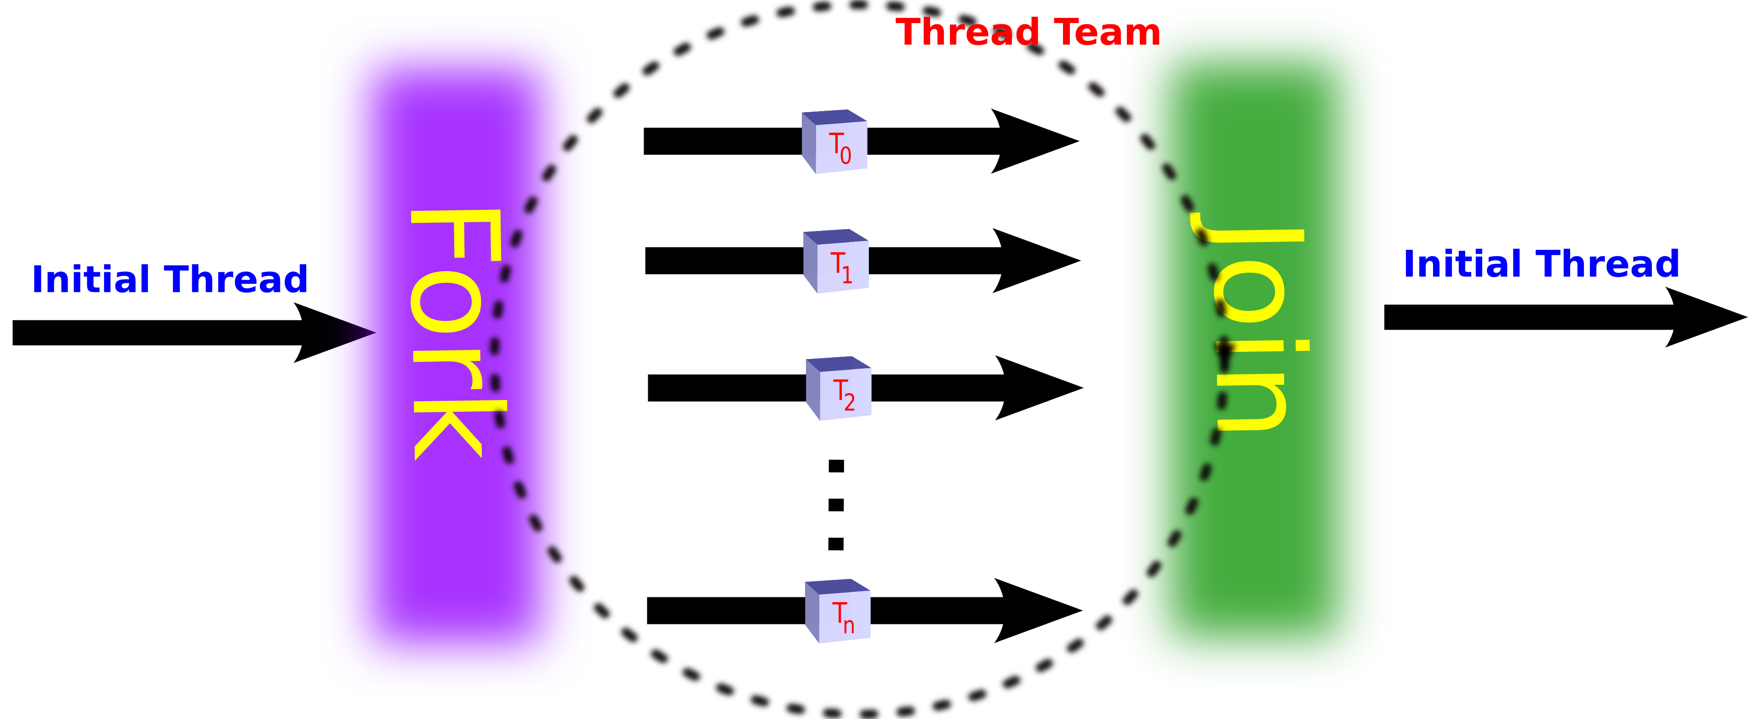
An interesting application: Work stealing
:
for(i = 0; i < N; i++) {
a[i] = f(i); // f() is an expensive computation
}
:
Key idea: If possible, share expensive work across multiple processors
:
parallel_for(i = 0; i < N; i++) {
a[i] = f(i);
}
:
Fork-join model:
Task scheduler needs to
assign iterations to processors
<number>
<number>

Slide 71
Sharing the workload
:
for(i = 0; i < N; i++) {
a[i] = f(i); // f() is an expensive computation
}
:
Naïve strategy: Split the iterations evenly among processors
e.g., if there are 4 processors P₁, P₂, P₃, P₄ then
does very poorly if some iterations take much longer than others
Task scheduler cannot predict this!
Even if it could, finding the optimal split is NP-hard
0 | N/4 | N/2 | 3N/4
P₁
P₂
P₃
P₄
<number>
<number>

Slide 72
Work-Stealing Heuristic
Each available processor will maintain a deque of tasks (sub-ranges)
P₁’s deque:
P₁ processes its deque bottom-up
if P₁ done, it steals from top of P_{random}’s deque
An improvement:
0 | N/4 | N/2 | 3N/4
P₁
P₂
P₃
P₄
0
N/8
3N/16
0
N/8
N/16
0
≤ grainsize
0
N/8
N/8
0
N/16
0
<number>

Slide 73
Two Pointers per Node
Recall that our doubly-linked lists require two pointers per DLL_Node:
typedef struct dllnode {
data_t data;
struct dllnode *prev;
struct dllnode *next;
} DLL_node;
Observation: Suppose A_{i} is the address of the i^{th} node in the DLL
We often maintain a pointer p to the i^{th} node
What if we maintained consecutive pointers p and q?
If sizeof(data_t) is the size
of a pointer, that is 3× space!
data_{i}
A_{i−1}
A_{i+1}
Redundant data
data_{i+1}
A_{i}
A_{i+2}
p
A_{i}
q
A_{i+1}
<number>

Slide 74
XOR trick!
A new definition of DLL_Node:
typedef struct dllnode {
data_t data;
int xor_PN;
} DLL_node;
To compute A_{i−1}: p->xor_PN ^ q
To compute A_{i+2}: p ^ q->xor_PN
Interview question: How do you do this in Java?
Assuming sizeof(pointer)
= sizeof(int)
O(1) space
overhead!
p
A_{i}
data_{i}
A_{i−1}⊕A_{i+1}
q
A_{i+1}
data_{i+1}
A_{i}⊕A_{i+2}
<number>

Slide 75
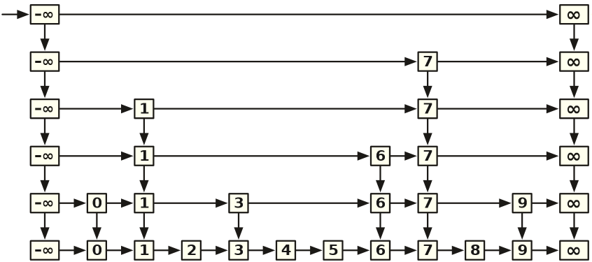
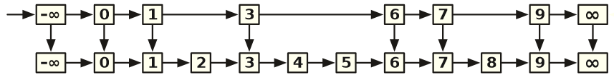
Another clever use: Skip Lists
Suppose we want to maintain a set of integers and support Find, Insert and Delete operations efficiently
Sorted list?
Option 1: ArrayList will do Find in O(log n) time, but Insert/Delete will each take O(n) time
Option 2: LinkedList will require O(n) time in the worst case for all
Option 3: Short-cuts (instead of prev, maintain a down pointer)
Find(5) vs. Find (6)
Worst case for Find?
Now extend this idea recursively!
Worst-case running time: O(n)
Expected worst-case: O(log n)
<number>

Slide 76
Practice Exam 1
You are allowed to bring ONE A4-sized cheat sheet
double-sided, handwritten only
The exam will have FOUR questions (30 points)
Question 1 (Bad recursion, List): 4 points; multi-select (like independent T/F questions, but selecting all/deselecting all will earn 0 points)
Question 2 (Asymptotic analysis, List): 6 points; multi-select
Question 3 (C programming, DLL): 10 points (no penalty for minor syntax errors)
Question 4 (Stack or Queue ADT): 5+5 points; critique your friend’s prototype and suggest a better one
<number>
Notes:
<number>

Slide 77
Question 1 (4 points)
Consider this INCORRECT implementation of the forall function in the List ADT defined in class:
1: ListEntry forall(List list,
int(*task)(int, void*),
void *args) {
2: ListEntry s = start(list);
3: if(s == NULL) { return NULL; }
4: if(!task(getData(s), args)) {
5: return list;
6: }
7: return forall(next(list, s), task, args);
8: }
The code is incorrect because:
A) list can be NULL in Line 2
B) s can be NULL in Line 4
C) there is a logical error in Line 5
D) Line 7 can cause infinite recursion
<number>
Notes:
<number>

Slide 78
Question 2 (6 points)
The following function returns the first position of data in list, or returns -1 if no such position exists:
int findPosition(List list, int data) {
ListEntry e = start(list);
if(e == NULL) { return -1; }
for(int i = 0; i < size(list); ++i) {
if(getData(e) == data) { return i; }
e = next(list, e);
}
return -1;
}
The worst-case running time on a list with n elements is
A) O(n) with ArrayList1 implementation
B) O(n) with ArrayList2 implementation
C) O(n) with LinkedList1 implementation
D) O(n) with LinkedList2 implementation
<number>
Notes:
<number>

Slide 79
Question 3 (10 points)
Complete the following C function:
int sameDLL(DLL_node *p, DLL_node *q) {
// Assume that p != NULL && q != NULL
// Return 1 if p and q are part of the
// same doubly-linked list, and return
// 0 otherwise
}
<number>
Notes:
<number>

Slide 80
Question 4 (5+5 points)
Consider the Stack ADT. We want to add a new operation multi_pop that pops the top k data items from the stack and stores them in a List (items appear in the list in the order in which they were popped). The List should be NULL if the operation fails for any reason, or if k ≤ 0.
Critique the following function prototype proposed by your friend:
List multi_pop(Stack s, int k);
Based on your critique, propose a better prototype for this function.
<number>
Notes:
<number>

Slide 81
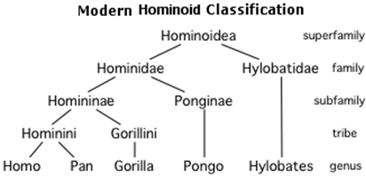
Trees
A data structure for hierarchical data
data stored in nodes (or vertices)
Every node except the root has exactly one parent
root
depth = 0
siblings
child 1
child 2
height
= 3
internal
node
leaf 1
leaf 2
depth = 2
Vocabulary
Root node
Leaf node
Edge
Child/parent
Siblings
Internal node
Ancestor/descendent
Depth of a node
Height of a tree
non-linear!
leaf 3
parent 1
parent 2
illegal
child
<number>
Notes:
<number>

Slide 82
Binary Trees
A binary tree is a tree where each internal node has at most two children
sometimes indicated as left-child and right-child
Implementation:
typedef struct node {
int data; /* or some other type */
struct node *left;
struct node *right;
} tNode;
If an internal node only has one child, left or right will be NULL
for a leaf, left = right = NULL
To access: tNode *root; /* NULL, if tree is empty */
<number>
Notes:
<number>

Slide 83
Creating a node
Suppose we want to create a new node containing some data D
the left child should be the sub-tree L
the right child should be the sub-tree R
L and R could be empty
tNode *makeNode(int D, tNode *L, tNode *R) {
tNode *node = (tNode *) malloc(sizeof(tNode));
if(node == NULL) { return NULL; }
node->data = D;
node->left = L;
node->right = R;
return node;
}
D
L
R
<number>
Notes:
<number>

Slide 84
Question
What kind of a tree does the following code make?
tNode *makeNode(int D, tNode *L, tNode *R) {
/* code from previous slide */
}
void main() {
tNode *n1, *n2, *n3, *n4, *root;
n1 = makeNode(1, NULL, NULL);
n2 = makeNode(2, n1, NULL);
n3 = makeNode(3, NULL, NULL);
n4 = makeNode(4, n3, n2);
root = makeNode(0, NULL, n4);
}
0
4
3
2
1
<number>
Notes:
<number>

Slide 85
Simplified forall function for trees
Suppose we want to print all nodes in a tree:
void forall(tNode *node) {
if(node == NULL) { return; }
printf("%d\n", node->data);
forall(node->left);
forall(node->right);
}
Question 1: What happens on this?
Question 2: How about with this change?
first version: preorder traversal (this, left, right)
second version: inorder traversal (left, this, right)
also: postorder traversal (left, right, this)
0
4
3
2
1
<number>
Notes:
<number>

Slide 86
Simplified forall function for trees
Suppose we want to print all nodes in a tree:
void forall(tNode *node) {
if(node == NULL) { return; }
printf("%d\n", node->data);
forall(node->left);
forall(node->right);
}
Question 1: What happens on this?
Question 2: How about with this change?
first version: preorder traversal (this, left, right)
second version: inorder traversal (left, this, right)
also: postorder traversal (left, right, this)
0
4
3
2
1
<number>
Notes:
<number>

Slide 87
General preorder
tNode *preorder(tNode *node,
int(*task)(int, void*), void*),
void *args) {
if(node == NULL) { return NULL; }
if(!task(node->data, args)) { return node; }
tNode *temp = preorder(node->left, task, args);
if(temp != NULL) { return temp; }
return preorder(node->right, task, args);
}
<number>
Notes:
<number>

Slide 88
Question
What does this function compute?
int strange(tNode *node) {
if(node == NULL) { return 0; }
return strange(node->left)
+ node->data
+ strange(node->right);
}
For the example: 0 + 3 + 4 + 1 + 2
in general, sum of data
Question: The above function uses inorder traversal. What would happen if we used preorder traversal? Postorder?
0
4
3
2
1
<number>
Notes:
<number>

Slide 89
Freeing memory
The following function frees memory used by a tree:
void freeTree(tNode *node) {
if(node == NULL) { return; }
freeTree(node->left);
freeTree(node->right);
free(node);
}
Question: The above function uses postorder traversal. What would happen if we used inorder traversal? Preorder?
4
freeTree(node->left);
free(node);
freeTree(node->right);
3
2
1
<number>
Notes:
<number>

Slide 90
An application: expression trees
Evaluating the tree:
// assume node != NULL
int eval(tNode *node) {
if(isInt(node->data)) {
return toInt(node->data);
}
if(isPlus(node->data)) {
return eval(tNode->left)
+ eval(tNode->right);
}
if(isMult(node->data)) { ... }
if(isUMinus(node->data)) {
return –eval(node->left);
}
// never reach here
}
+
3
*
-
9
1
6
<number>
Notes:
<number>

Slide 91
Ordered Binary Trees
Suppose the data-type used in tree nodes supports ordering
e.g., any two ints can be compared using <
We can then define an ordered binary tree where every node x satisfies this ordering property:
the data at all nodes in x’s left sub-tree is less than or equal to the data at node x
the data at all nodes in x’s right sub-tree is greater than the data at node x
Finding data in a tree
without the ordering property
with the ordering property
2
1
4
3
<number>
Notes:
<number>

Slide 92
Finding data in an ordered tree
This function assumes that node is the root of an ordered tree
int find(tNode *node, int D) {
if(node == NULL) { return 0; }
if(D == node->data) {
return 1;
} else if(D < node->data) {
return find(node->left, D);
} else {
return find(node->right, D);
}
}
2
1
4
3
<number>
Notes:
<number>

Slide 93
Finding data in an ordered tree
This function assumes that node is the root of an ordered tree
int find(tNode *node, int D) {
if(node == NULL) { return 0; }
if(D == node->data) {
return 1;
} else if(D < node->data) {
return find(node->left, D);
} else {
return find(node->right, D);
}
}
2
1
4
3
<number>
Notes:
<number>

Slide 94
Inserting data into an ordered tree
Our ordered tree data structure will not permit duplicate data
can be modified to allow duplicates
tNode *insert(tNode *node, int D) {
if(node == NULL) {
return makeNode(D, NULL, NULL);
}
if(D < node->data) {
node->left =
insert(node->left, D);
} else if(D > node->data) {
node->right =
insert(node->right, D);
}
return node;
}
D
2
0
5
3
<number>
Notes:
<number>

Slide 95
Understanding insert
Draw the tree that will be created
tNode *insert(tNode *node, int D) {
/* code from previous slide */
}
void main() {
tNode* root =
insert(
insert(
insert(NULL, 1),
2),
3);
}
1
2
insert(
insert(
insert(NULL, 2),
3),
1);
2
1
3
3
Question 1: Worst-case running time?
Question 2: What if makeNode fails?
<number>
Notes:
<number>

Slide 96
A better insert
tNode *insert(tNode *node, int D) {
if(find(node, D)) { return NULL; }
tNode *newNode = makeNode(D, NULL, NULL);
if(newNode == NULL) { return NULL; }
return rec_ins(node, newNode);
}
tNode *rec_ins(tNode *node, tNode *newNode) {
if(node == NULL) { return newNode; }
if(newNode->data < node->data) {
node->left = rec_ins(node->left, newNode);
} else if(newNode->data > node->data) {
node->right = rec_ins(node->right, newNode);
}
return node;
}
If newNode is the root of an ordered tree,
will rec_ins merge the two ordered trees?
<number>
Notes:
<number>

Slide 97
Merging two trees
Write a function to merge all nodes from src into dest
tNode *merge(tNode *src, tNode *dest) {
if(src == NULL) { return dest; }
dest = insert(dest, src->data);
dest = merge(src->left, dest);
return merge(src->right, dest);
}
The above code traverses src nodes in preorder
what if we used inorder? Postorder?
If both trees have n nodes initially, how long will merge take?
<number>
Notes:
<number>

Slide 98
Deleting data from an ordered tree
Recall that our ordered trees do not permit duplicates
tNode *delete(tNode *node, int D) {
if(node == NULL) { return NULL; }
if(D < node->data) {
node->left = delete(node->left, D);
} else if(D > node->data) {
node->right = delete(node->right, D);
} else {
tNode *oldNode = node;
node = merge(node->left, node->right);
freeTree(oldNode->left);
free(oldNode);
}
return node;
}
Slow because it:
does not recycle old nodes
wastefully compares data in node->left, node->right subtrees
<number>
Notes:
<number>

Slide 99
What does this code do?
tNode *extractMax(tNode *node, tNode *ans) {
// assume node != NULL
if(node->right == NULL) {
ans->data = node->data;
tNode *temp = node->left;
free(node);
return temp;
}
node->right = extractMax(node->right, ans);
return node;
}
tNode *extractMin(tNode *node, tNode *ans) {
/* similar */
}
<number>
Notes:
<number>

Slide 100
A better delete
tNode *delete(tNode *node, int D) {
if(node == NULL) { return NULL; }
if(D < node->data) {
node->left = delete(node->left, D);
} else if(D > node->data) {
node->right = delete(node->right, D);
} else {
if(node->left != NULL)
node->left = extractMax(node->left, node);
else if(node->right != NULL)
node->right = extractMin(node->right, node);
else { free(node); return NULL; }
}
return node;
}
<number>
Notes:
<number>

Slide 101
Exam 1: Review
Question 1 (4 points): What is the error?
1: void freeList(List list) {
2: Node *this = (Node *) list;
3: if(this != NULL)
4: freeList(this->next);
5: free(this);
6: }
Question 2 (6 points): Worst-case time complexity for size n list:
ListEntry previous(List list, ListEntry e);
ArrayList1
LinkedList 1
Bad typecast?
No base-case?
Type mismatch?
Segmentation fault?
O(1)
O(log n)
O(n)
<number>
Notes:
<number>

Slide 102
Question 3 (10 points)
int sizeOf(DLL_node *node) {
// assume node != NULL;
/* Idea: start from node and go
backwards until NULL, and go
forwards until NULL, counting
as you go
*/
int ans = 1;
for(DLL_node *p=node->prev; p != NULL; p = p->prev)
ans++;
for(DLL_node *p=node->next; p != NULL; p = p->next)
ans++;
return ans;
}
<number>
Notes:
<number>

Slide 103
Question 4 (5+5 points)
int peek(Queue); // returns data at front of queue
first = peek(myQueue);
No way to signal failure on empty queue
int peek(Queue q, int *peeked_value);
if(peek(myQueue, &first)) { ... }
int peek(Queue q, int *error_flag);
first = peek(myQueue, &ok);
if(ok) { ... }
<number>
Notes:
<number>

Slide 104
Balanced Search Trees
How long does it take to determine whether a particular value x appears in an ordered tree T containing n nodes?
Worst case time is O(h), where h is the height of T
Minimum height (T is balanced):
Maximum height (T is lopsided):
Key idea: Keep the tree balanced (prevent it from getting lopsided)
A ≤ ≤ B ≤ ≤ C
h = ⎣log₂ n⎦
h = n − 1
Rotate right
C
Left Left
A
Right Right
Rotate left
A
B
B
C
<number>
Notes:
<number>

Slide 105

Dealing with Left Right and Right Left
Do a double-rotation!
Rotate right
Rotate left
C
C
A
B₂
A
B₁
B₂
C
B₁
B₂
A
B₁
AVL Trees: Ensure that height
difference between left and
right sub-trees is at most 1
<number>
Notes:
<number>

Slide 106
AVL Tree Implementation
typedef struct node {
int data; /* or some other type */
struct node *left;
struct node *right;
int height;
} tNode;
int h(tNode *node) {
return node == NULL ? -1 : node->height;
}
tNode *makeNode(int D, tNode *L, tNode *R) {
tNode *node = (tNode *) malloc(sizeof(tNode));
...
node->height = 1 + MAX(h(L), h(R));
return node;
}
<number>
Notes:
<number>

Slide 107
Insert in an AVL tree
tNode *rec_ins(tNode *node, tNode *newNode) {
if(node == NULL) { return newNode; }
if(newNode->data < node->data) {
node->left = rec_ins(node->left, newNode);
if(h(node->left) > h(node->right)) {
node->height = h(node->left) + 1;
}
} else if(newNode->data > node->data) {
node->right = rec_ins(node->right, newNode);
if(h(node->right) > h(node->left)) {
node->height = h(node->right) + 1;
}
}
return balance(node);
}
tNode *insert(tNode *node, int D) {
if(find(node, D)) { return NULL; }
tNode *newNode = makeNode(D, NULL, NULL);
if(newNode == NULL) { return NULL; }
return rec_ins(node, newNode);
}
<number>
Notes:
<number>

Slide 108
Balancing nodes in an AVL tree
tNode *balance(tNode *node) {
if(node == NULL) { return NULL; }
if(h(node->left) > h(node->right)+1) {
if(h(node->left->left) > h(node->left->right) {
return handleLL(node);
} else {
return handleLR(node);
}
} else if(h(node->right) > h(node->left)+1) {
if(h(node->right->right) > h(node->right->left)) {
return handleRR(node);
} else {
return handleRL(node);
}
} else { return node; }
}
<number>
Notes:
<number>

Slide 109
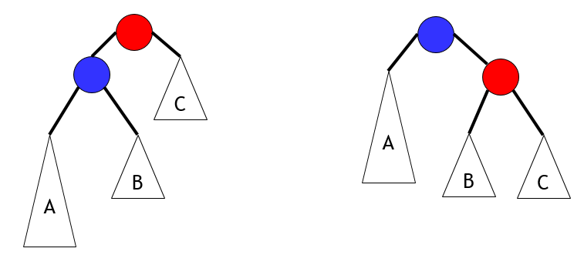
handleLL
tNode *handleLL(tNode *node) {
tNode *A, *B, *C, *result;
result = node->left;
A = result->left;
B = result->right;
C = node->right;
result->right = node;
node->left = B;
node->height = 1 + MAX(h(B), h(C));
result->height = 1 + MAX(h(A), node->height);
return result;
}
O(1) time
Hence, balance() is also O(1) time
Thus, insert is O(h)
We will prove that h is O(log n)
node
result
<number>
Notes:
<number>

Slide 110
Delete in an AVL tree
tNode *delete(tNode *node, int D) {
if(node == NULL) { return NULL; }
if(D < node->data)
node->left = delete(node->left, D);
else if(D > node->data)
node->right = delete(node->right, D);
else {
if(node->left != NULL)
node->left = extractMax(node->left, node);
else if(node->right != NULL)
node->right = extractMin(node->right, node);
else { free(node); return NULL; }
}
node->height = 1 + MAX(h(node->left), h(node->right));
return balance(node);
}
<number>
Notes:
<number>

Slide 111
Space overhead per node
Our AVL tree nodes store the (absolute) height of each node in the tree
typedef struct node {
int data;
struct node *left;
struct node *right;
int height; // sizeof(int) overhead per node
} tNode;
This can be reduced to two bits overhead per node:
LeftHeavy, Balanced, RightHeavy
Slightly more complex insert/delete/balance
another example of the space/time tradeoff!
<number>
Notes:
<number>

Slide 112
AVL trees with n nodes have O(log n) height
Recall: AVL Trees ensure that height difference between left and right sub-trees is at most 1
Let m(h) be the minimum number of nodes in an AVL tree of height h
If an AVL tree with n nodes has height h then n ≥ m(h)
Hence, h ≤ m⁻¹(n) [assuming m is an increasing function]
Now m(0) = 1, m(1) = 2, m(2) = 4, m(3) =
∀h ≥ 2, m(h) = 1 + m(h − 1) + m(h − 2)
F(0) = F(1) = 1; ∀h ≥ 2, F(h) = F(h − 1) + F(h − 2)
Prove that ∀h ≥ 0, m(h) = F(h+2) − 1
1 +
m(2) +
m(1)
= 7
<number>
Notes:
<number>

Slide 113
Critique this “proof”
Given: m(0) = 1, m(1) = 2; ∀h ≥ 2, m(h) = 1 + m(h − 1) + m(h − 2)
and F(0) = F(1) = 1; ∀h ≥ 2, F(h) = F(h − 1) + F(h − 2)
We will prove that ∀h ≥ 0, m(h) = F(h+2) − 1 by induction on h
Base case (h = 0): m(0) = 1 and F(2) = F(0) + F(1) = 1 + 1 = 2
so the base case holds ☺
Inductive step (h > 0): m(h) = 1 + m(h − 1) + m(h − 2)
= 1 + F(h+1) − 1 + F(h) − 1 by the inductive hypothesis
= F(h+2) − 1 by the definition of F
☺
Fails for h = 1
<number>
Notes:
<number>

Slide 114
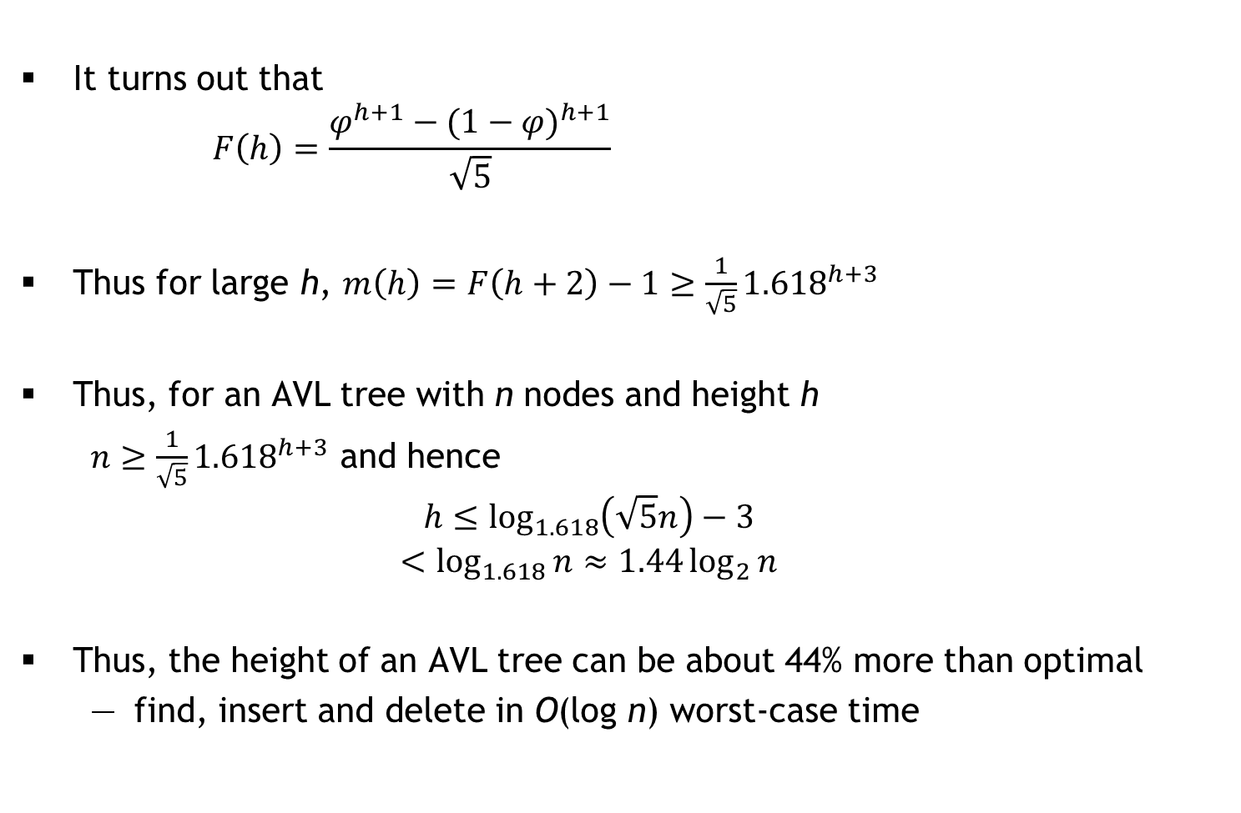
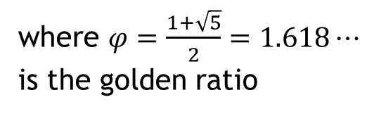
Fibonacci numbers and the Golden Ratio
It turns out that
Thus for large h,
Thus, for an AVL tree with n nodes and height h
and hence
Thus, the height of an AVL tree can be about 44% more than optimal
find, insert and delete in O(log n) worst-case time
where
is the golden ratio
<number>
Notes:
<number>

Slide 115
Dictionary ADT
A dictionary stores (key, value) pairs where keys are totally ordered
e.g., integers, reals, vectors, strings, …
For a key k, a dictionary has at most one pair (k, v)
#ifndef DICT_H
#define DICT_H
typedef void* DictEntry;
void setValue(DictEntry, value_t);
value_t getValue(DictEntry);
typedef void* Dict;
void freeDict(Dict);
int isEmpty(Dict);
int size(Dict);
Dict insert(Dict, key_t, value_t);
DictEntry get(Dict, key_t);
Dict delete(Dict, key_t);
DictEntry forall(Dict, int(*task)(int, void*), void*);
#endif
int cmp(key_t, key_t)
Assuming cmp runs
in O(1) time!
Linked list | AVL tree
O(1) | O(1)
O(n) | O(n)
O(n) | O(log n)
Replace old value if
key already exists
<number>
Notes:
<number>

Slide 116
Research Note
A comparison of dictionary implementations by Mark Neyer, 2009
This paper explores several implementations of dictionaries:
hash tables, Red-Black Trees, AVL Trees, and Skip Lists
The Microsoft .NET platform was chosen for this experiment because it is of interest to the author’s experience in industry, and due to the availability of a precise memory measurement debugging library, namely sos.dll
Implementations
System.Collections.hashtable
AVL tree implementation: www.vcskicks.com
Red-Black tree implementation: www.devx.com/DevX/Article/36196
Skip List implementation: www.codeproject.com/KB/recipes/ skiplist1.aspx
No mention of hardware!
<number>
Notes:
<number>

Slide 117
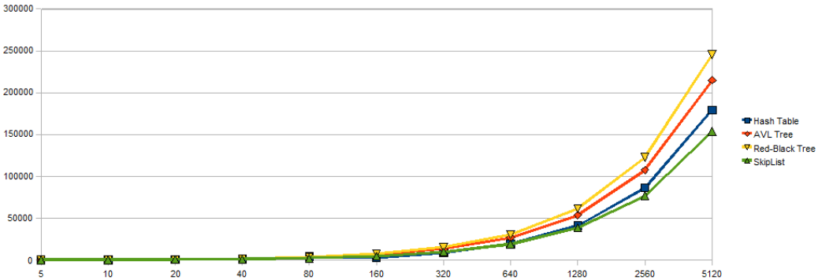
Results (1/3)
Size (in bytes) vs. n
<number>
Notes:
<number>

Slide 118
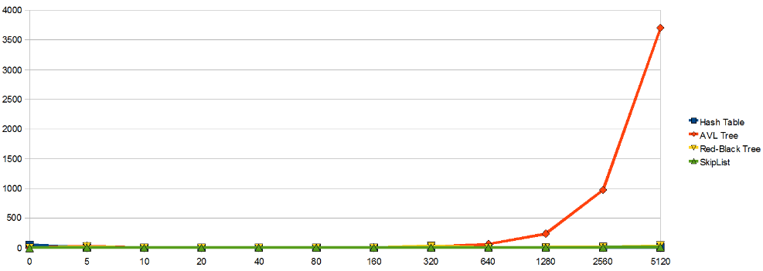
Results (2/3)
Creation time (in milliseconds) vs. n
<number>
Notes:
<number>

Slide 119
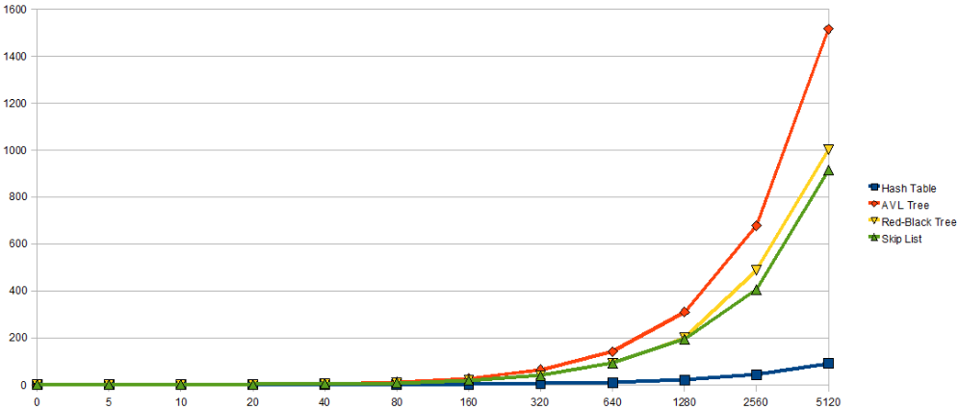
Results (3/3)
Query time for 100n keys (in milliseconds) vs. n
<number>
Notes:
<number>

Slide 120
Priority Queues
A priority queue is an ADT for storing (priority, data) pairs, where priorities are totally ordered (e.g., integers, strings, etc.)
Two variants (silly English):
low-magnitude priority means “high priority”
high-magnitude priority means “high priority”
#ifndef PQUEUE_H
#define PQUEUE_H
typedef void* PQEntry;
typedef void* PQueue;
int size(PQueue);
PQEntry insert(PQueue *pq, int priority, int data);
int deleteNext(PQueue pq, int *priority, int *data);
PQEntry update(PQueue pq, PQEntry e, int newPriority);
#endif
<number>
Notes:
<number>

Slide 121
Priority Queue Implementations
Interview question: All n (priority, data) items known in advance, only need deleteNext. What is the best implementation?
AVL trees: pointer-based, large constant hidden in the O(.)
We will develop a fast, array-based implementation
size in O(1) time
insert and deleteNext in O(log n) time [smaller constant]
 | Linked List | Ordered Linked List | Ordered Binary Tree | Balanced Ordered Binary Tree
size | O(1) | O(1) | O(1) | O(1)
insert | O(1) | O(n)
deleteNext | O(n) | O(1)
update
O(n)
O(log n)
O(n)
O(log n)
O(1)
O(n)
O(n)
O(log n)
<number>
Notes:
<number>

Slide 122
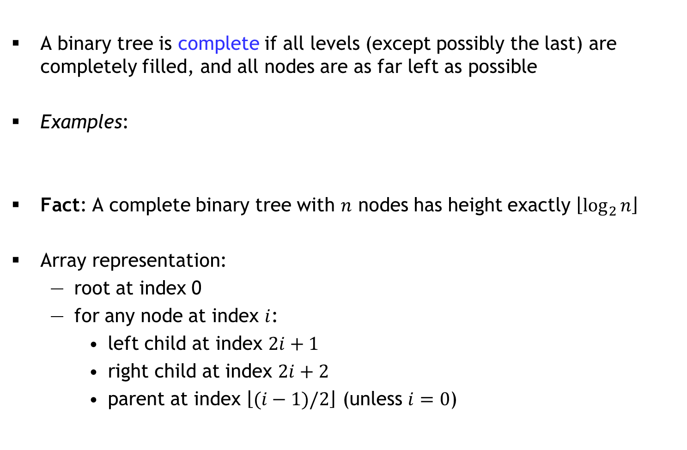
Complete Binary Trees
A binary tree is complete if all levels (except possibly the last) are completely filled, and all nodes are as far left as possible
Examples:
Fact: A complete binary tree with nodes has height exactly
Array representation:
root at index 0
for any node at index :
left child at index
right child at index
parent at index (unless )
<number>
Notes:
<number>

Slide 123
Heaps
Definition:
A minheap is a complete binary tree in which every node’s priority is less than or equal to the priority of its children (min. at root)
A maxheap is a complete binary tree in which every node’s priority is greater than or equal to the priority of its children (max. at root)
We implement a heap as an array
Question: Which of these arrays represent minheaps?
A
1 | 2 | 3 | 4 | 5 | 6
B
1 | 2 | 4 | 5 | 6 | 3
C
1 | 3 | 4 | 2 | 6 | 5
D
1 | 4 | 2 | 6 | 5 | 3
<number>
Notes:
<number>

Slide 124
Sift Up
Suppose the heap is implemented as a struct with array a[] where each array is a struct with priority p and data d
void siftUp(Heap *H, int i) { // minheap
while(i > 0) {
int j = (i-1)/2; // parent
if(H->a[i].p >= H->a[j].p) { return; }
SWAP(H->a, i, j);
i = j;
}
}
What does siftUp(H, 3) do if H->a =
Insert = append to array + sift up the last element: O(log n) time
Why not: SWAP(H->a[i], H->a[j])
Temporary?
1 | 3 | 4 | 2 | 6 | 5
<number>
Notes:
<number>

Slide 125
Sift Up
Suppose the heap is implemented as a struct with array a[] where each array is a struct with priority p and data d
void siftUp(Heap *H, int i) { // minheap
while(i > 0) {
int j = (i-1)/2; // parent
if(H->a[i].p >= H->a[j].p) { return; }
SWAP(H->a, i, j);
i = j;
}
}
Insert = append to array + sift up the last element: O(log n) time
Time to “heapify” n items: O(n log n)
<number>
Notes:
<number>

Slide 126
Sift Down
void siftDown(Heap *H, int i) { // minheap
while(i < (H->size)/2) { // i >= size/2 is leaf!
int j = 2*i+1; // left child
if(j < H->size-1 && H->a[j].p > H->a[j+1].p)
j++; // right child
if(H->a[i].p <= H->a[j].p) { return; }
SWAP(H->a, i, j);
i = j;
}
}
What does siftDown(H, 0) do if H->a =
deleteNext = swap root with last, size--, siftDown(0): O(log n) time
update?
7 | 2 | 4 | 3 | 6 | 5
<number>
Notes:
<number>

Slide 127
Heapify in O(n) time
void heapify(Heap *H) { // minheap
for(int i = H->size/2-1; i >= 0; i--) {
siftDown(H, i);
}
}
Runtime analysis: O(n) iterations, each takes O(log n) time: O(n log n)
Careful runtime analysis?
Heapsort
Two advanced data structures: Treaps and Fibonacci heaps
Sloppy
<number>
Notes:
<number>

Slide 128


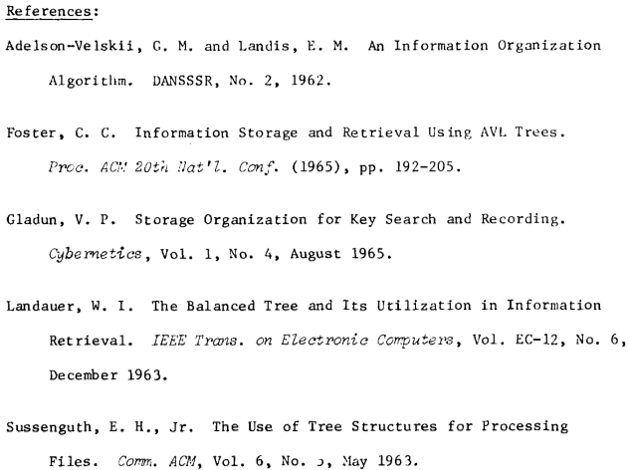
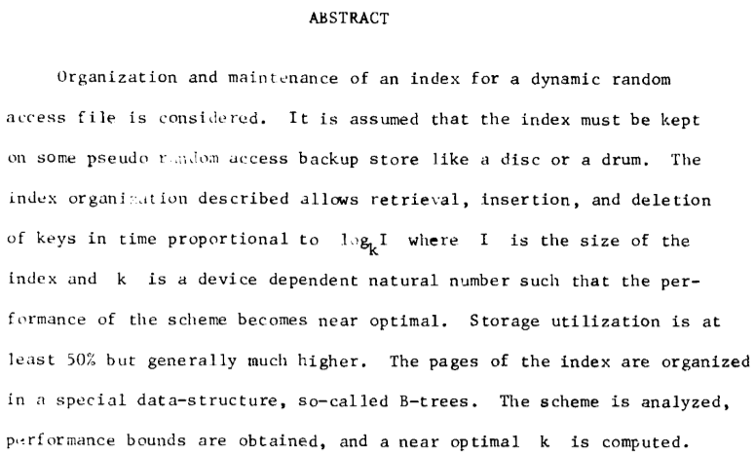
B-trees
Actually in 1970
<number>
Notes:
<number>

Slide 129
Large amount of data
Need to store most of the data on disk (or in the cloud)
getting data from these sources is MUCH slower than RAM
Key idea: If we have to go to the disk, make it count!
each disk access fetches a whole block of data (a few KB)
Component | Latency | Adjusted
1 CPU cycle | 0.3 ns | 1 second
L1 cache access | 0.9 ns | 3 seconds
L2 cache access | 2.8 ns | 9 seconds
L3 cache access | 12.9 ns | 43 seconds
RAM access | 120 ns | 6 minutes
SSD access | 50-150 μs | 2-6 days
HDD access | 1-10 ms | 1-12 months
SF to NYC internet | 40 ms | 4 years
Data from 2014
<number>
Notes:
<number>

Slide 130
Nodes in a B-tree
In a B-tree of order m, each node has up to m children
The root is either a leaf, or has at least two children
Each internal node except the root has between ⎡m/2⎤ and m children
All leaves are at the same level
tree height is ≈ log_{m} n
m is of the order of 10² or more, so for n ≈ 10⁹, depth is around 5
d₁ | d₂ | … | d_{m−1}
m chosen so that
m − 1 data elements
+ m “pointers” fill a
disk block
< d₁
(d₁, d₂)
> d_{m−1}
<number>
Notes:
<number>

Slide 131
Operations on B-trees
Find is a generalization of Find for ordered binary trees
binary search used to find the correct pointer to follow
To insert d, find the leaf node where it should have been
insert into that node (in sorted order)
if the node was full (i.e., it had m − 1 elements), promote the middle element to the parent-level and split this into two half-filled nodes
promote/split may cascade up to the root (tree height will grow)
Delete is similar: remove data, then try to compress with adjacent sibling
d₁ | d₂ | … | d_{m−1}
< d₁
(d₁, d₂)
> d_{m−1}
<number>
Notes:
<number>

Slide 132
An optimization: B⁺ trees
Suppose data is made up of (small) keys and (large) values
search done on the basis of keys
Internal nodes only store keys
values are stored only at leaves
Thus, a single disk block can accommodate many more keys
bushier tree ⇒ shallower tree
Insert animation from OpenDSA
<number>
Notes:
<number>

Slide 133
B/B⁺ trees: Frequent nodes
In both B-trees and B⁺-trees, the root is processed frequently
While the data structure is needed, the root can be stored in RAM
the root can be written out to the disk when the data structure is no longer needed by the program (e.g., when the program terminates)
RAM is large enough to accommodate more than just the root
but it cannot accommodate everything
Note: This is exactly the problem of caching
cache faster than RAM (just like RAM faster than disk)
cache smaller than RAM (just like RAM smaller than disk)
Key Question: What to save and what to evict?
<number>
Notes:
<number>

Slide 134
Eviction Strategies
FIFO: First In First Out
data structure?
LRU: Least Recently Used
data structure?
FF: Furthest in Future
provably optimal
data structure?
Aside: Splay trees
whenever you insert or find something, splay it to the top
O(log n) amortized find/insert/delete
<number>
Notes:
<number>

Slide 135
Questions
In a full tree, every node has either 0 or 2 children
What is the maximum height of a full tree with n nodes
Given pointers p and q to two nodes in an balanced binary search tree (ordered binary tree) with n nodes, describe a fast algorithm to find the lowest common ancestor of p and q
Answer the same question, assuming that the tree is unordered and not necessarily balanced
In a general tree, nodes can have an arbitrary number of children
Describe a space-efficient way to implement general trees in C
<number>
Notes:
<number>

Slide 136
Graphs
A graph is a data structure representing objects and their interactions
e.g., objects: Facebook users; interaction: Facebook friendship
Formally, objects: vertices; interactions: edges
If there is an edge between vertices u and v (notation: uv), then u and v are neighbours in the graph
Graphs can be:
undirected or directed [direction of interaction]
unweighted or weighted [strength of interaction]
without/with self-loops and parallel edges
<number>
Notes:
<number>

Slide 137
Graph Representation
Consider a graph with V vertices numbered 0, 1, …, V − 1
We can represent the edges as an array nbr[] where for each vertex u:
nbr[u] is an array of V bits, nbr[u][v] = 1 iff uv is an edge
Adjacency matrix representation
nbr[u] is a linked list containing all neighbours of u
Adjacency list representation
Question: Which representation is more appropriate for Facebook?
<number>
Notes:
<number>

Slide 138

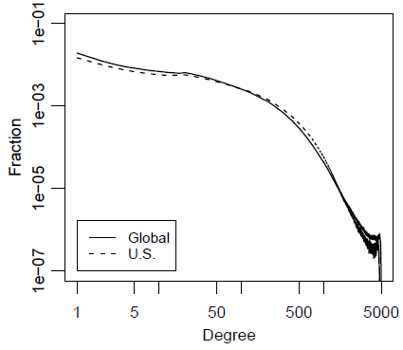
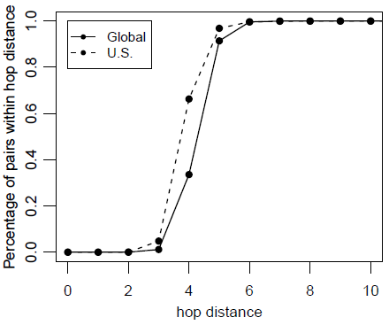
An interesting paper on the FB graph (2011)
<number>

Slide 139
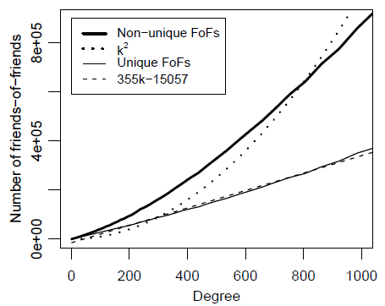
Friends of friends
The number of (unique) vertices within two hops of a given vertex
Measures feasibility of graph search algorithms
If the average number of friends is k, a naïve analysis suggests k² FoFs
A user with 100 friends has
27,500 unique FoFs and
40,300 non-unique FoFs
Much more than 100²!
“Your friends have more
friends than you” (Feld 1991)
<number>

Slide 140
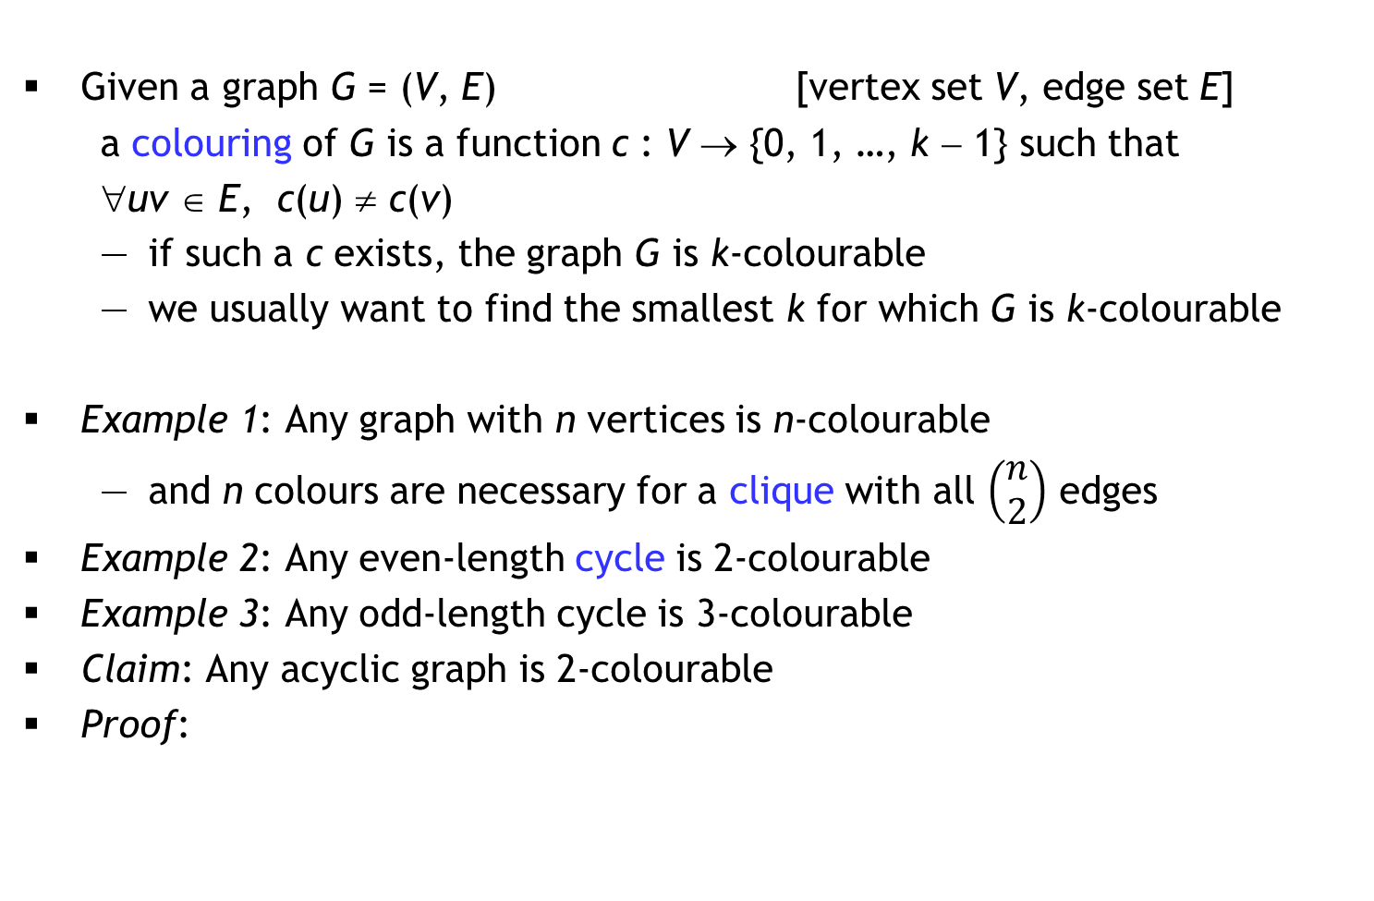
Graph Colouring
Given a graph G = (V, E) [vertex set V, edge set E]
a colouring of G is a function c : V → {0, 1, …, k − 1} such that
∀uv ∈ E, c(u) ≠ c(v)
if such a c exists, the graph G is k-colourable
we usually want to find the smallest k for which G is k-colourable
Example 1: Any graph with n vertices is n-colourable
and n colours are necessary for a clique with all edges
Example 2: Any even-length cycle is 2-colourable
Example 3: Any odd-length cycle is 3-colourable
Claim: Any acyclic graph is 2-colourable
Proof:
<number>

Slide 141
☺
Your friend claims that…
If the max. vertex degree in a graph G is d, then G is (d+1)-colourable
“Proof”: Suppose the vertices in G are numbered 0, 1, …, n − 1
for(v = 0; v < n; v++)
c[v] = -1; // illegal colour
for(v = 0; v < n; v++)
for(i = 0; i <= d; i++)
available[i] = true;
for all neighbours u of v in G
if(c[u] != -1)
available[c[u]] = false;
for(i = 0; !available[i]; i++)
/* nothing */;
c[v] = i;
Running time?
Adj. matrix | Adj. list
O(n²)
O(nd)
Number of colours
used depends on
vertex numbering
0
0
1
3
1
2
3
4
2
4
5
5
<number>

Slide 142
Adapted from a former Facebook puzzle
“Liar, Liar”
You have just joined an internet forum, and you notice that existing forum members either always lie, or always tell the truth.
You want to split the members into two groups (liars and truth-tellers), so you ask each forum member for a list of liars.
Assume that everyone else has perfect knowledge about others but is busy, so each person will respond with only a partial list of people that they accuse of being liars. Of course these lists shouldn’t be taken at face value because of all the lying going on.
Describe an algorithm that uses these lists to either solve the problem, or determines that it cannot be solved.
<number>

Slide 143
Graph Traversal
Consider a bag data structure that supports add and remove operations in O(1) time
traverse(G, s)
for each v in G
visited[v] = false;
bag = {};
visited[s] = true;
bag.add(s);
while(bag != {})
v = bag.remove();
for each neighbour u of v
if(!visited[u])
visited[u] = true;
bag.add(u);
Bag = Queue ⇒ traverse = Breadth First Search (BFS)
Suppose G has n vertices
and m edges
Observation 1: A vertex
is added/removed at most
once from the bag
So, O(n²) with adj. matrix
Observation 2: Sum of all
vertex degrees is 2m
So, O(n + m) with adj. list
O(n)
iterations
<number>
Notes:
<number>

Slide 144
Applications of BFS
Determine whether a graph is connected/identify the components
Find a shortest path between two vertices u and v (if one exists)
also works for directed graphs
Determine if a graph contains a cycle
Determine if a graph is 2-colourable (i.e., bipartite)
is2colourable(G)
compute BFS level array;
for each vertex v in G
c[v] = (level[v] % 2);
for each edge uv in G
if(c[u] == c[v]) return false;
return true;
is3colourable(G)
??
$1,000,000
<number>

Slide 145
Weighted graphs
Consider a weighted, directed graph where each edge (u, v) has a real-valued weight w(u, v)
Can also define a weighted undirected graph, where w(u, v) = w(v, u)
Single-Source Shortest Path (SSSP): Given a particular vertex s, determine the shortest distance d[v] from s to v for every vertex v
Here, distance = sum of edge weights along a walk from s to v
All-Pairs Shortest Path (APSP): Determine the shortest distance d[u, v] between any two vertices u and v
Note: Negative edge weights can be a problem!
<number>

Slide 146
Generic SSSP
SSSP(G, s)
for each v in G
d[v] = ∞;
parent[v] = -1;
d[s] = 0;
bag = {s};
while bag != {}
u = bag.remove();
for each neighbour v of u
if(d[v] > d[u] + w(u, v))
d[v] = d[u] + w(u, v);
parent[v] = u;
bag.add(v);
If weights are positive, each vertex is added/removed once from bag
s
u
v
If SSSPs exist, this
algorithm will find them
Running time depends on
“bag” data structure
If “bag” is priority queue
with priority(v) = d(v), we
have Dijkstra’s algorithm
<number>

Slide 147


Priority Queue recap
Implementation using a minheap:
O(log n) for insert, delete minimum, update
Implementation using a Fibonacci heap:
O(log n) amortized time for delete minimum
O(1) amortized time for insert and update
Dijkstra’s algorithm on a graph with n vertices
and m edges performs:
n inserts
n delete mins
m updates
Robert Tarjan
<number>

Slide 148
Minimum Spanning Tree (MST)
A tree is a connected, acyclic graph
A subgraph of G = (V, E) is H = (V’, E’) where V’ ⊆ V and E’ ⊆ E
a spanning tree of G is a subgraph T = (V, E’) such that T is a tree
only exists if G is connected
Useful fact: |E’| = |V| − 1
Consider a weighted, undirected, connected graph G = (V, E) where each edge uv has a real-valued weight w(uv)
Assume that all edge-weights are distinct
We want to find a spanning tree of G whose sum of edge weights is minimized
Generic MST algorithm: Maintain a forest F whose edges form an MST for each connected component (initially, no edges), and repeatedly add edges
<number>

Slide 149
Growing the forest F by adding edges
Let e be the lightest edge with exactly one endpoint in a component of F
the other endpoint is in a different component of F, or not in F
Suppose there is an MST T which does not include edge e = uv
Then there is a path in T from u to v
This path has an edge e’ with exactly one endpoint in this component
So w(e) < w(e’)
Consider the spanning tree T − e’ + e [why is it a tree?]
Now w(T − e’ + e) = w(T) − w(e’) + w(e)
< w(T), a contradiction [why?]
Initialize F = ({u}, ∅) [Prim], or F = (V, ∅) [Kruskal]
e
Key Lemma: The edge
e must belong to the MST
e’
Priority Queue
Union Find
<number>

Slide 150
Hashing
A hashtable is a data structure that stores (key, value) pairs so that given a key x, we can efficiently find the value associated with x (if any)
Key idea: Use an array T[0.. m−1] and choose a hash function that maps keys to array indices
Notation: Keys are chosen from a set K of size n; h(x) ∈ {0, …, m−1}
If m < n, there will clearly be collisions (Pigeonhole Principle)
i.e., for distinct x and y, h(x) = h(y)
collisions may occur when m ≥ n for some hash functions
We want:
a fast to compute hash function that minimizes collisions
a way to deal with collisions in case they arise
<number>
Notes:
<number>

Slide 151
Determinism or Randomization?
If we pick a deterministic hash function for our program, then each time our program is run each pair of keys x and y will either always collide or never collide
if we have several collisions for some input, we will always have several collisions for that input
e.g., h(x) = integer(x) mod m
We need randomization, but our hash function cannot be random (why?)
Solution: Choose a hash function h uniformly at random from a family of hash functions F
each h ∈ F is deterministic
Ideal (?): F is the set of all possible functions from K to {0, …, m−1}
many of these have no simple representation
<number>
Notes:
<number>

Slide 152
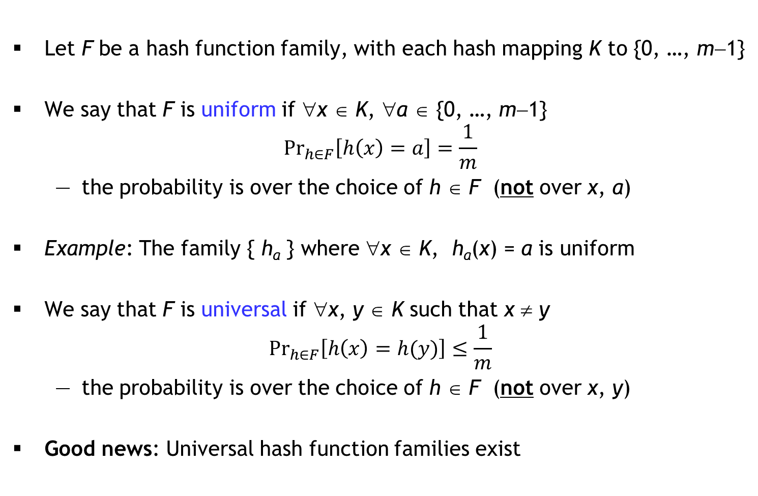
Uniform and Universal hash function families
Let F be a hash function family, with each hash mapping K to {0, …, m−1}
We say that F is uniform if ∀x ∈ K, ∀a ∈ {0, …, m−1}
the probability is over the choice of h ∈ F (not over x, a)
Example: The family { h_{a} } where ∀x ∈ K, h_{a}(x) = a is uniform
We say that F is universal if ∀x, y ∈ K such that x ≠ y
the probability is over the choice of h ∈ F (not over x, y)
Good news: Universal hash function families exist
but not
universal!
<number>
Notes:
<number>

Slide 153
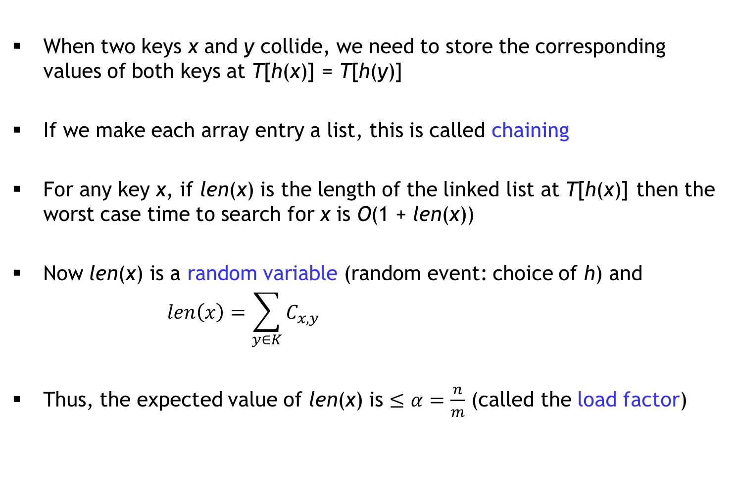
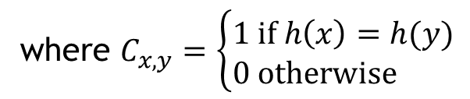
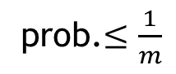
Chaining
When two keys x and y collide, we need to store the corresponding values of both keys at T[h(x)] = T[h(y)]
If we make each array entry a list, this is called chaining
For any key x, if len(x) is the length of the linked list at T[h(x)] then the worst case time to search for x is O(1 + len(x))
Now len(x) is a random variable (random event: choice of h) and
Thus, the expected value of len(x) is (called the load factor)
where
prob.
<number>
Notes:
<number>

Slide 154
Chaining
When two keys x and y collide, we need to store the corresponding values of both keys at T[h(x)] = T[h(y)]
If we make each array entry a list, this is called chaining
For any key x, if len(x) is the length of the linked list at T[h(x)] then the worst case time to search for x is O(1 + len(x))
Now len(x) is a random variable (random event: choice of h) and
Thus, the expected value of len(x) is (called the load factor)
where
prob.
<number>
Notes:
<number>

Slide 155
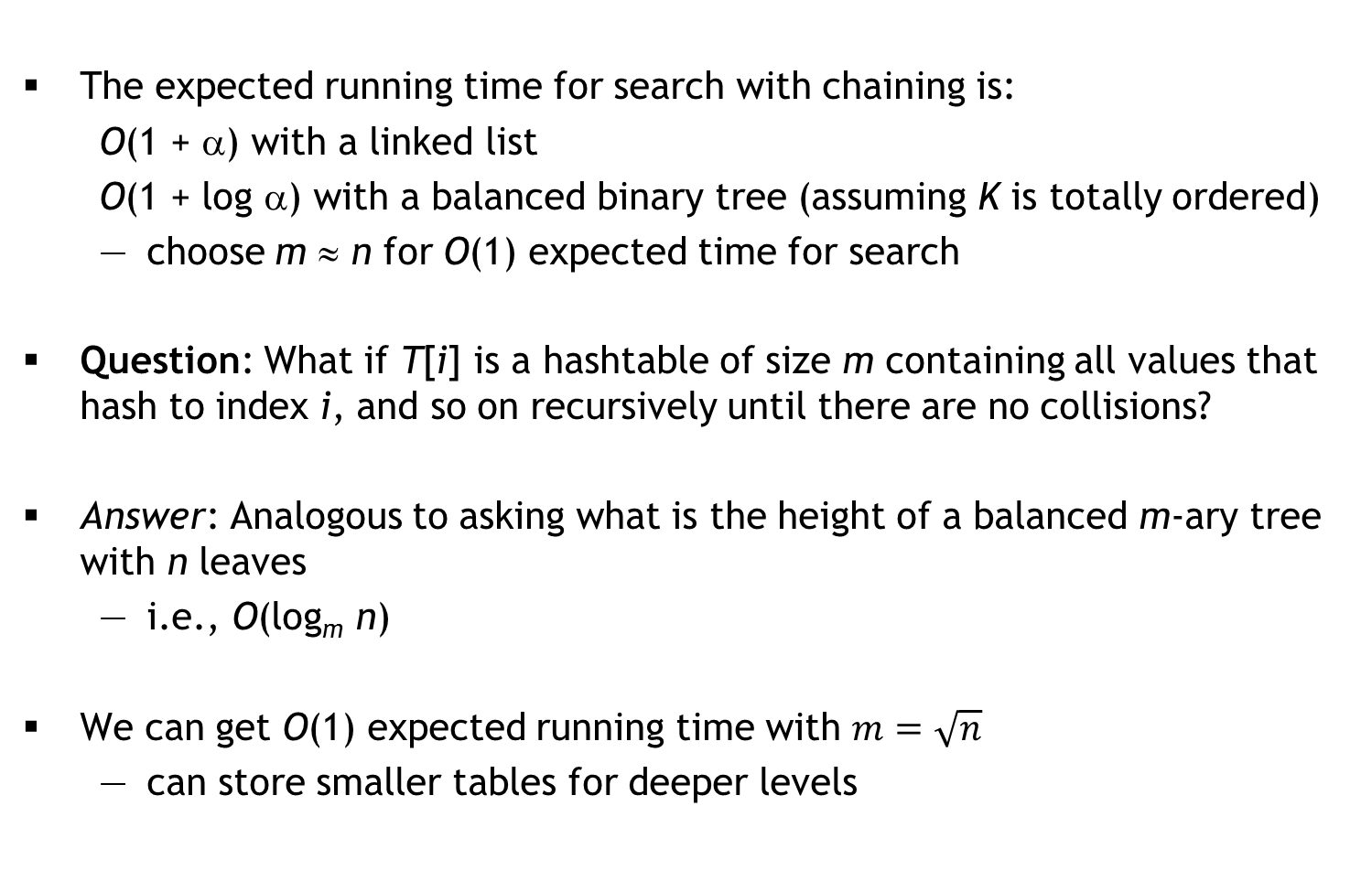
Advanced Chaining
The expected running time for search with chaining is:
O(1 + α) with a linked list
O(1 + log α) with a balanced binary tree (assuming K is totally ordered)
choose m ≈ n for O(1) expected time for search
Question: What if T[i] is a hashtable of size m containing all values that hash to index i, and so on recursively until there are no collisions?
Answer: Analogous to asking what is the height of a balanced m-ary tree with n leaves
i.e., O(log_{m} n)
We can get O(1) expected running time with
can store smaller tables for deeper levels
<number>
Notes:
<number>

Slide 156
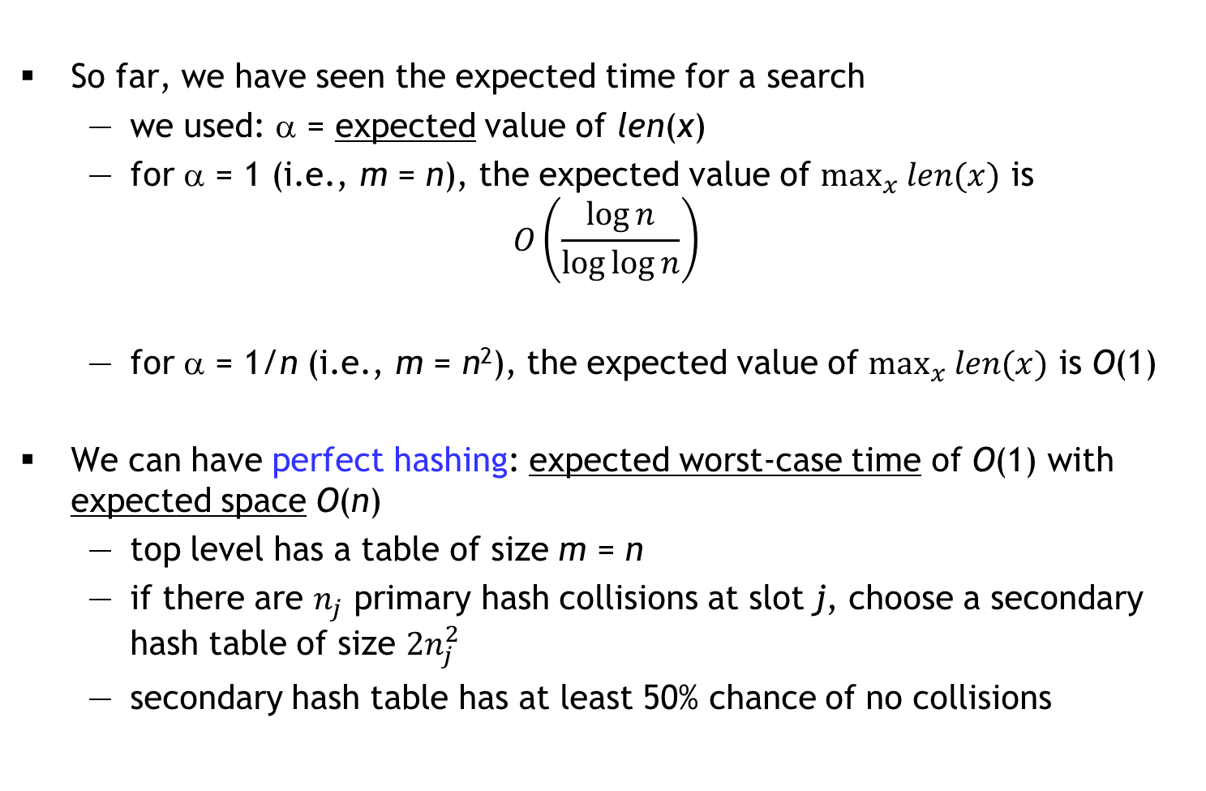
Expected worst case
So far, we have seen the expected time for a search
we used: α = expected value of len(x)
for α = 1 (i.e., m = n), the expected value of is
for α = 1/n (i.e., m = n²), the expected value of is O(1)
We can have perfect hashing: expected worst-case time of O(1) with expected space O(n)
top level has a table of size m = n
if there are primary hash collisions at slot j, choose a secondary hash table of size
secondary hash table has at least 50% chance of no collisions
<number>
Notes:
<number>

Slide 157
Open Addressing: an alternative to chaining
Suppose we want to hash keys in K to {0, 1, …, m − 1}
each entry T[i] will contain one (key, value) pair or it will be empty
Instead of a single hash function h, we have a sequence of hash functions h₀, h₁, …, h_{m − 1} such that ∀x ∈ K
the probe sequence h₀(x), h₁(x), …, h_{m − 1}(x)
is a permutation of 0, 1, …, m − 1
We search for an item x at indices according to the probe sequence
we stop when we find x or an empty slot
hopefully, we don’t need too much of the probe sequence
Ideal case (strong uniform hashing): For any x, the probe sequence is equally likely to be any of the permutations of 0, 1, …, m − 1
<number>
Notes:
<number>

Slide 158
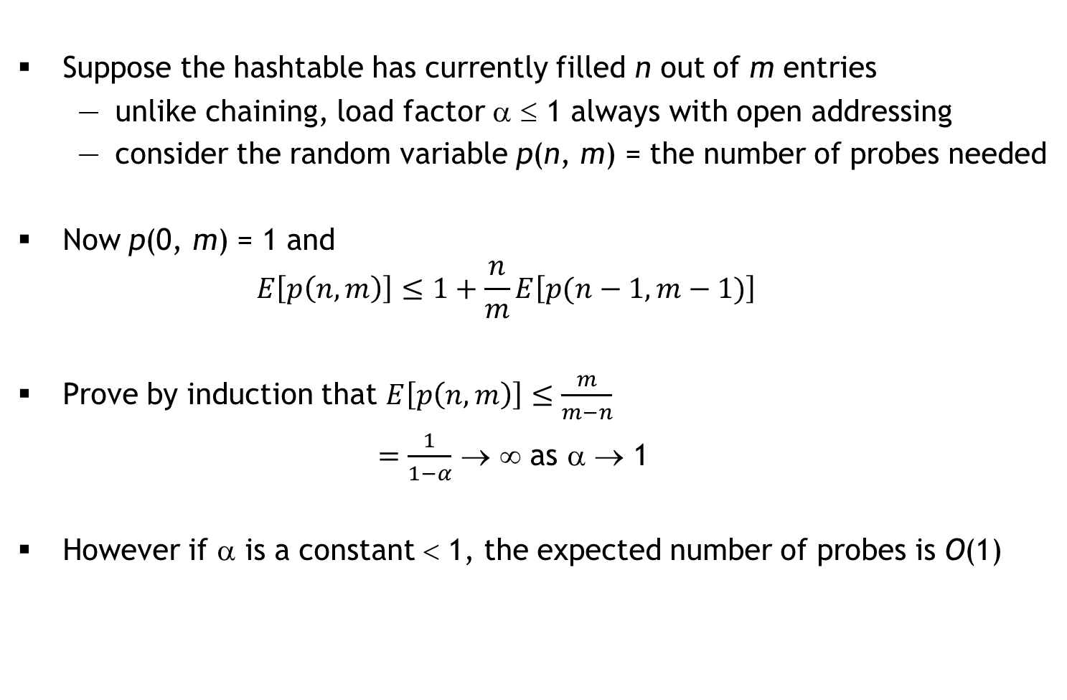
Analysis with strong uniform hashing assumption
Suppose the hashtable has currently filled n out of m entries
unlike chaining, load factor α ≤ 1 always with open addressing
consider the random variable p(n, m) = the number of probes needed
Now p(0, m) = 1 and
Prove by induction that
→ ∞ as α → 1
However if α is a constant < 1, the expected number of probes is O(1)
<number>
Notes:
<number>

Slide 159
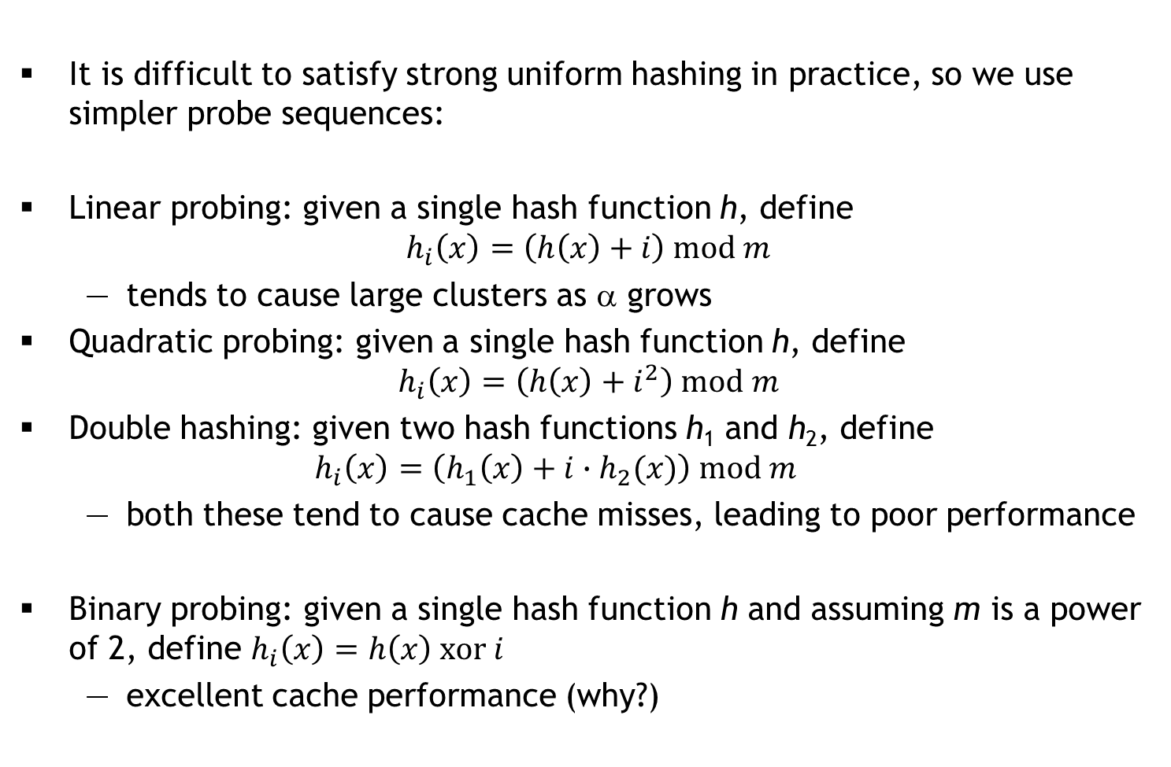
Common Probe Sequences
It is difficult to satisfy strong uniform hashing in practice, so we use simpler probe sequences:
Linear probing: given a single hash function h, define
tends to cause large clusters as α grows
Quadratic probing: given a single hash function h, define
Double hashing: given two hash functions h₁ and h₂, define
both these tend to cause cache misses, leading to poor performance
Binary probing: given a single hash function h and assuming m is a power of 2, define
excellent cache performance (why?)
<number>
Notes:
<number>

Slide 160
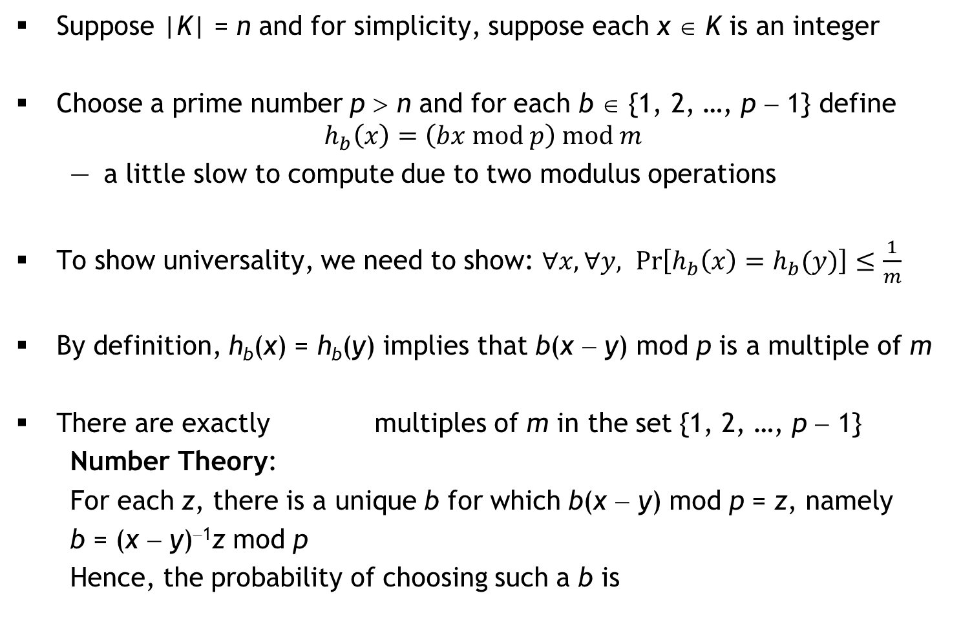
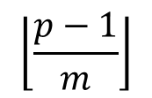
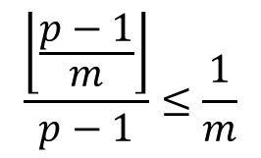
Prime Multiplicative Hash Family
Suppose |K| = n and for simplicity, suppose each x ∈ K is an integer
Choose a prime number p > n and for each b ∈ {1, 2, …, p − 1} define
a little slow to compute due to two modulus operations
To show universality, we need to show:
By definition, h_{b}(x) = h_{b}(y) implies that b(x − y) mod p is a multiple of m
There are exactly multiples of m in the set {1, 2, …, p − 1}
Number Theory:
For each z, there is a unique b for which b(x − y) mod p = z, namely
b = (x − y)⁻¹z mod p
Hence, the probability of choosing such a b is
<number>
Notes:
<number>

Slide 161
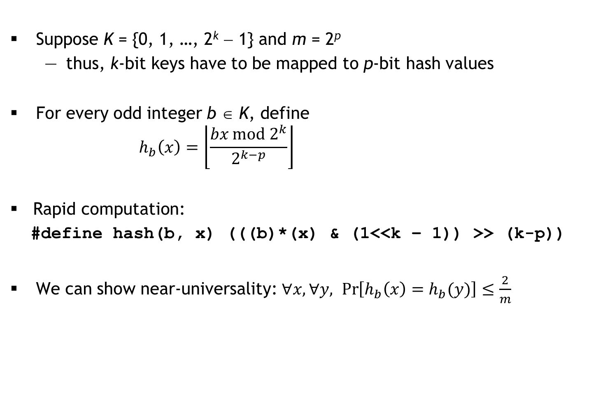
Binary Multiplicative Hash Family
Suppose K = {0, 1, …, 2^{k} − 1} and m = 2^{p}
thus, k-bit keys have to be mapped to p-bit hash values
For every odd integer b ∈ K, define
Rapid computation:
#define hash(b, x) (((b)*(x) & (1<<k – 1)) >> (k-p))
We can show near-universality:
<number>
Notes:
<number>

Slide 162
Code analysis: Java HashMap
public class Graph {
public Graph(int n) { /* create an n-vertex graph */ }
public void addEdge(int u, int v) { /* add uv edge */ }
public static void main(String[] args) {
HashMap<Graph, String> map =
new HashMap<Graph, String>();
Graph g1 = new Graph(3);
Graph g2 = new Graph(3);
map.put(g1, "g1");
map.put(g2, "g2");
System.out.println(map.get(g1));
System.out.println(map.get(g2));
}
}
Question:
What is printed?
Why?
<number>
Notes:
<number>

Slide 163
Auto-generated equals and hashCode methods
public class Graph {
@Override public int hashCode() {
final int prime = 31;
int result = 1;
result = prime * result + Arrays.hashCode(nbr);
result = prime * result + numVertices;
return result;
}
@Override public boolean equals(Object obj) {
if (this == obj) return true;
if (obj == null) return false;
if (getClass() != obj.getClass()) return false;
Graph other = (Graph) obj;
if (!Arrays.equals(nbr, other.nbr)) return false;
if (numVertices != other.numVertices) return false;
return true;
}
/* rest as before */
}
Question:
What is printed now?
What if we perform
g1.addEdge(0, 1)?
<number>
Notes:
<number>

Slide 164
What is printed now?
public class Graph {
@Override public int hashCode() {
/* auto-generated */
}
@Override public boolean equals(Object obj) {
/* auto-generated */
}
public static void main(String[] args) {
Graph g1 = new Graph(3);
Graph g2 = new Graph(3);
g1.addEdge(0, 1); g1.addEdge(0, 2);
g2.addEdge(0, 2); g2.addEdge(0, 1);
/* rest as before */
}
}
Question:
How do we fix this?
<number>
Notes:
<number>

Slide 165

An application of hashing: Map-Reduce
Developed by two researchers at Google
Many companies want to process large amounts of data quickly
without purchasing super-computers
Alternative: Split work across several nodes (off-the-shelf machines)
Risk of failures:
What if a node fails during computation?
How many hard-drive failures does Google suffer? ~1 per
minute
hour
day
month
<number>

Slide 166
The general map-reduce process
The input is split into chunks
Some nodes run map tasks on one or more chunks
each chunk is converted into a sequence of (key, value) pairs
keys don’t have to be unique
A master node gathers all (key, value) pairs and groups them into lists by key: (k₁, [v₁₁, v₁₂, …]) ; (k₂, [v₂₁, v₂₂, …]) ; …
Some nodes run reduce tasks: given one or more such lists, “reduce” the values in the list
Lastly, the master controller gathers the reduced values to produce the final answer
<number>

Slide 167
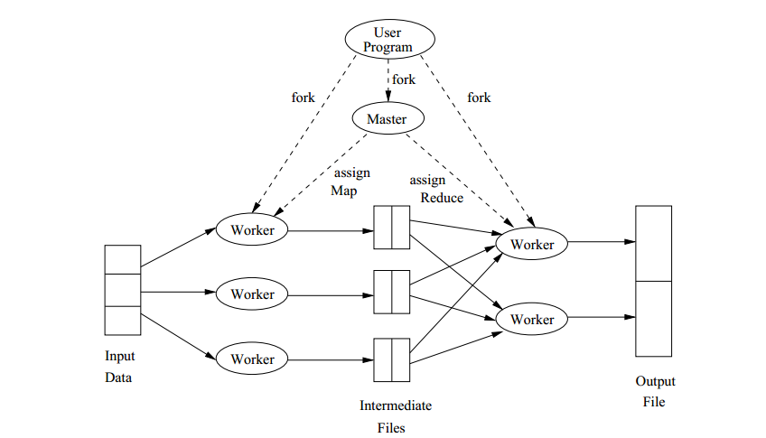
Overview
mappers
reducers
<number>

Slide 168
Example 1: Frequency of each word in large files
The chunks are files
Each map task is given one or more files
each file is converted into a sequence of pairs (word, 1)
The master node gathers all the (word, 1) pairs and groups them into lists by key: (w₁, [1, 1, …]) ; (w₂, [1, 1, …]) ; …
Each reduce task is given one or more such lists, and “reduces” the values in the list by adding all the 1’s
Lastly, the master controller gathers the reduced values to produce the final answer: (w₁, c₁) ; (w₂, c₂) ; …
<number>

Slide 169
Alternative strategy
If a word w appears m times in a file
the mapper will produce (w, 1), (w, 1), … m times
instead, what if the mapper produced just (w, m)?
Shifts some of the computation from the reducer to the mapper
but also reduces the amount of intermediate data!
original : m × (bitsize(w) + 1) bits
alternative : bitsize(w) + ⎡log₂(m)⎤ bits
Running time dominated by data transfer time between map/reduce nodes and the master
CPUs MUCH faster than the interconnect speed/local HDD rates
If input size totals N bits, key-value pairs total K bits, key-reduced pairs total R bits and the final output totals M bits, then
Communication Cost is O(N + K + R + M)
<number>

Slide 170
Example 2: Matrix-vector multiplication
Consider an n × n matrix A whose (i, j)^{th} element is a_{ij}, and an n × 1 vector v
The product Av is an n × 1 vector x where x_{i} =
Assume that vector v fits in each mapper’s memory, but n is very large so that A is stored in a file as a set of triples (i, j, a_{ij}) for non-zero a_{ij}
Each map task is assigned a chunk of the file, and maps (i, j, a_{ij}) to the pair (i, a_{ij}v_{j})
Each reduce task combines lists (i, [x_{i1}, x_{i2}, …]) into (i, x_{i1} + x_{i2} + …)
the master thread assembles and outputs vector x
<number>

Slide 171
Communication Cost Analysis for Example 2
Input: n × n matrix A whose m non-zero elements a_{ij} are stored as triples (i, j, a_{ij}), and an n × 1 vector v (each mapper has a RAM copy)
Output: product, an n × 1 vector x
Assume that each matrix/vector element has size b
N is O(m(b + log n))
K is O(m(b + log n))
R is O(n(b + log n))
M is O(nb)
Communication Cost is O((m + n)(b + log n))
Note: m is O(n²) but m << n² for sparse matrices
<number>

Slide 172
A variation
Consider the same situation as before, but suppose that n is so large that v cannot fit into memory
v stored in a file as n pairs (j, v_{j})
Consider the following map-reduce algorithm:
map each triple (i, j, a_{ij}) to (i, (j, a_{ij}))
map each pair (j, v_{j}) to n pairs: (i, (j, v_{j})) for every i
in order to reduce (i, L_{i}), find pairs (j, a_{ij}) and (j, v_{j}) in L_{i}, compute a_{ij}v_{j}, add these up to produce the sum x_{i} and lastly emit (i, x_{i})
Note: The list L_{i} may not fit in memory, in which case the above step would need to be performed as another map-reduce!
the master thread assembles and outputs vector x
Analyze the communication cost
<number>

Slide 173
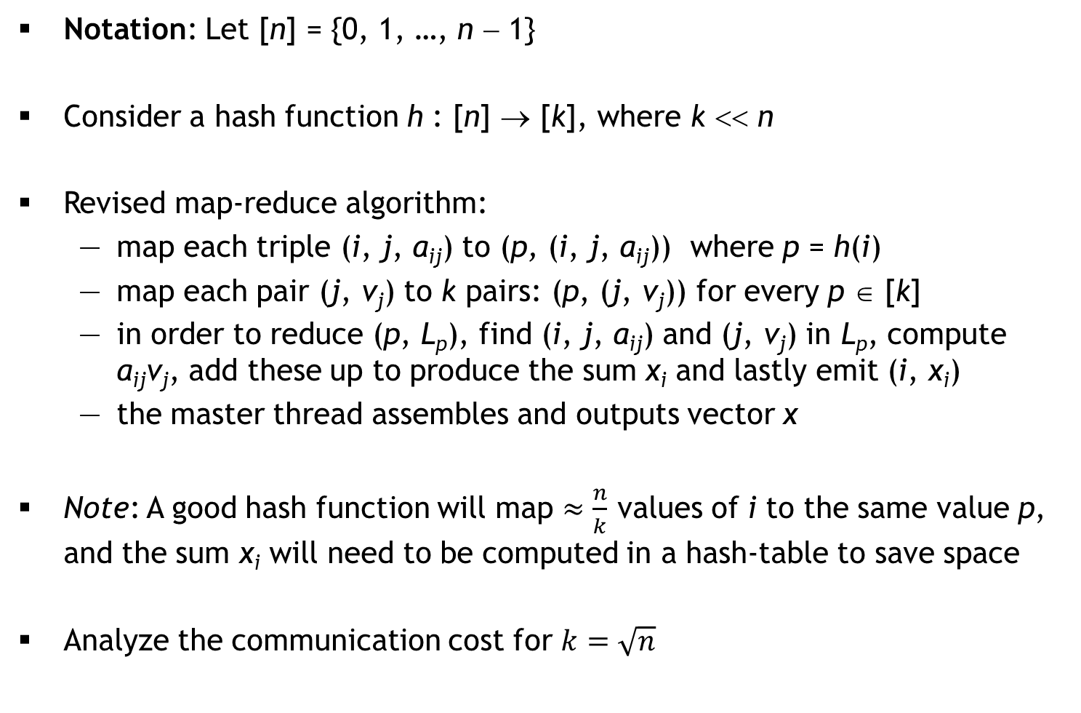
An improvement using hashing
Notation: Let [n] = {0, 1, …, n − 1}
Consider a hash function h : [n] → [k], where k << n
Revised map-reduce algorithm:
map each triple (i, j, a_{ij}) to (p, (i, j, a_{ij})) where p = h(i)
map each pair (j, v_{j}) to k pairs: (p, (j, v_{j})) for every p ∈ [k]
in order to reduce (p, L_{p}), find (i, j, a_{ij}) and (j, v_{j}) in L_{p}, compute a_{ij}v_{j}, add these up to produce the sum x_{i} and lastly emit (i, x_{i})
the master thread assembles and outputs vector x
Note: A good hash function will map values of i to the same value p, and the sum x_{i} will need to be computed in a hash-table to save space
Analyze the communication cost for
X = empty_hash()
for each (i, j, a_{ij}) in L_{p}
for each (j, v_{j}) in L_{p} {
if X contains value x_{i} for key i
insert (i, x_{i} + a_{ij}*v_{j}) into X
else
insert (i, a_{ij}*v_{j}) into X
}
emit all (i, x_{i}) pairs in X
<number>

Slide 174
Graph Isomorphism
Are these two graphs isomorphic?
The problem is easy when the graph is labeled
Is the problem hard when the graph is unlabeled?
1
2
1
2
4
5
3
4
3
6
5
6
<number>
Notes:
<number>

